Slide 1

BANK LOAN CASE STUDY
~ ARYAN AUDITTO

Slide 2
PROJECT DESCRIPTION :-
The project aims to analyze a loan risk of bank related to clients' loan applications and their payment difficulties. the dataset consists of two main files: "application_data.csv" containing client information at the time of application, and "previous_application.csv" containing data about the client's previous loan applications. The data given contains the information about the loan application at the time of applying for the loan. It contains two types of scenarios:
The client with payment difficulties: he/she had late payment more than X days on at least one of the first Y instalments of the loan in our sample
All other cases: All other cases when the payment is paid on time.
The objective is to gain insights into the factors influencing payment difficulties and develop a predictive model to identify potential risk factors in future loan applications.
The analysis approach involves several steps :
The dataset will be collected and loaded. Then, the data will be thoroughly understood by exploring the structure and contents of the dataset, and using the "columns_description.csv" file as a data dictionary to interpret the variables.
After understanding the data, the next step is data cleaning and preprocessing. Missing data will be identified and an appropriate method will be used to deal with it.
Once the data is cleaned, exploratory data analysis (EDA) will be performed. This includes analyzing the distribution of variables, examining correlations, and generating visualizations to uncover patterns.
Univariate, segmented univariate, and bivariate analyses will be conducted to understand the variables and their impact on the target variable (payment difficulties).
APPROACH :-

Slide 3
TECH-STACK USED :-
To complete the project, used tools such as Microsoft Excel to perform data analysis, create charts and graphs, along with PowerPoint to generate the report
INSIGHTS :-
Throughout the project, several insights were gained:
The missing data was identified and handled appropriately. Columns with a high percentage of missing values were either removed or imputed using appropriate methods such as mean, median, or mode.
Outliers were identified by analyzing the distribution of variables. Outliers are data points that deviate significantly from the majority of the data. While they were not removed for this exercise, their presence can provide valuable insights into potential anomalies or extreme cases.
Data imbalance was assessed by examining the ratio of payment difficulties to non-difficulties in the dataset. If the ratio is significantly skewed, it indicates an imbalance.
Univariate analysis provided insights into the distribution of individual variables. Segmented univariate analysis allowed us to analyze variables based on different segments, such as the target variable (payment difficulties) or other categorical variables. This helps in understanding the impact of different variables on the target variable.
Bivariate analysis explored the relationships between pairs of variables, providing insights into potential correlations and dependencies. By segmenting the data based on the target variable, we could identify the top correlations for clients with payment difficulties and all other cases. This analysis helps in identifying important factors that differentiate clients with payment difficulties from others.
RESULTS :-

Slide 4
APPLICATION_DATA
Hyperlink for working file :- Application_data complete
NOTE: Working files have been uploaded to google drive due to limit exceed
All the tasks are performed in this working file and each task is divided into separate sheets

Slide 5
1. Overall Approach of Analysis:-
The Bank loan statement is to analyze a dataset related to clients' loan applications and their payment difficulties.
The dataset consists of two main files:
"application_data.csv" containing client information at the time of application
"previous_application.csv" containing data about the client's previous loan applications.
Further explored the structure and contents of the dataset to gain a better understanding of the variables and their meanings. Used the "columns_description.csv" file as a data dictionary to interpret the variables.
Identify and handle missing values, outliers, and inconsistencies in the data and further performed an in-depth exploration of the dataset to uncover patterns, relationships, and trends.
After cleaning of data, following are columns consisting of categorical values and numerical values in the dataset :
Gender
Name Contract Type
Income Type
Education
Housing Type
Days Employed
Amount Income
Amount Credit
Amount Goods Price

Slide 6
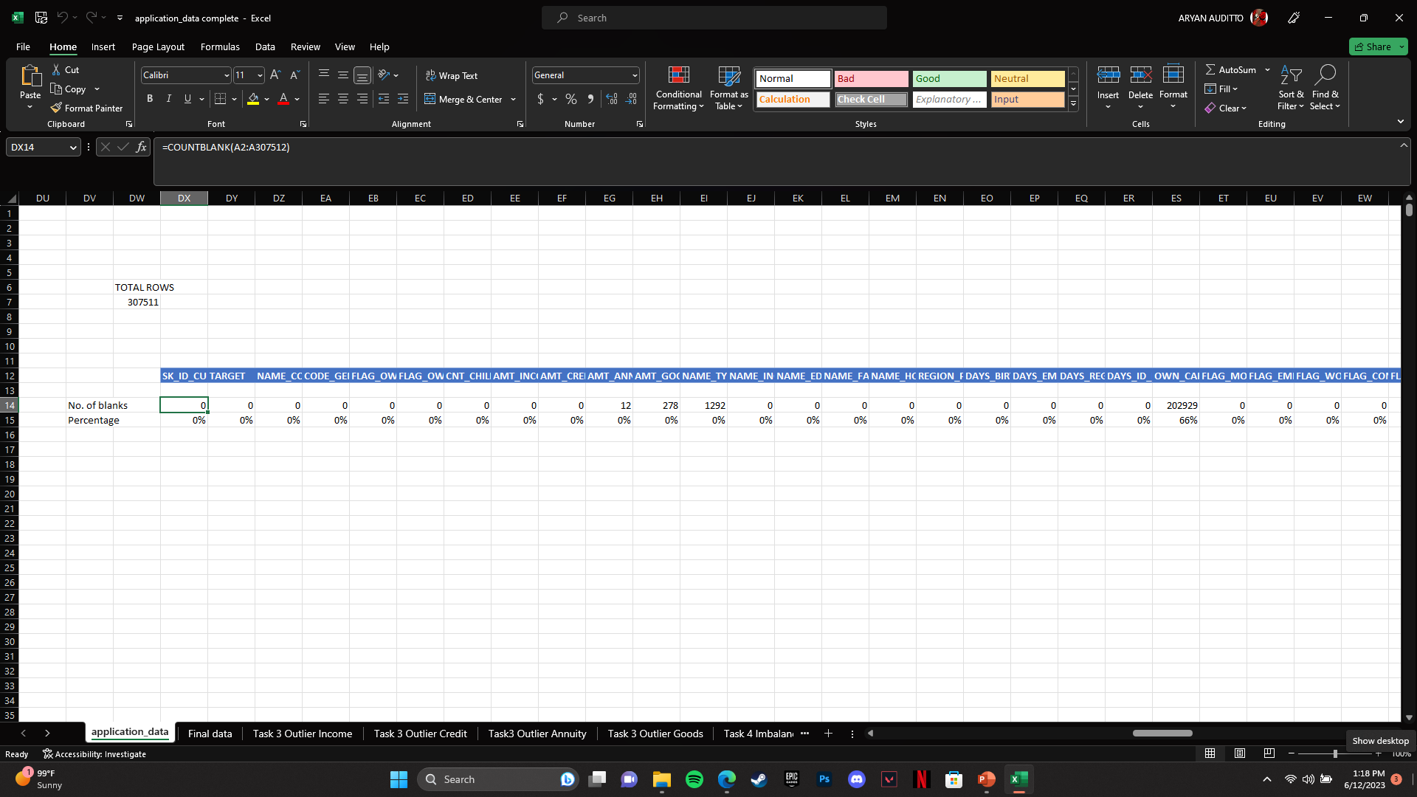
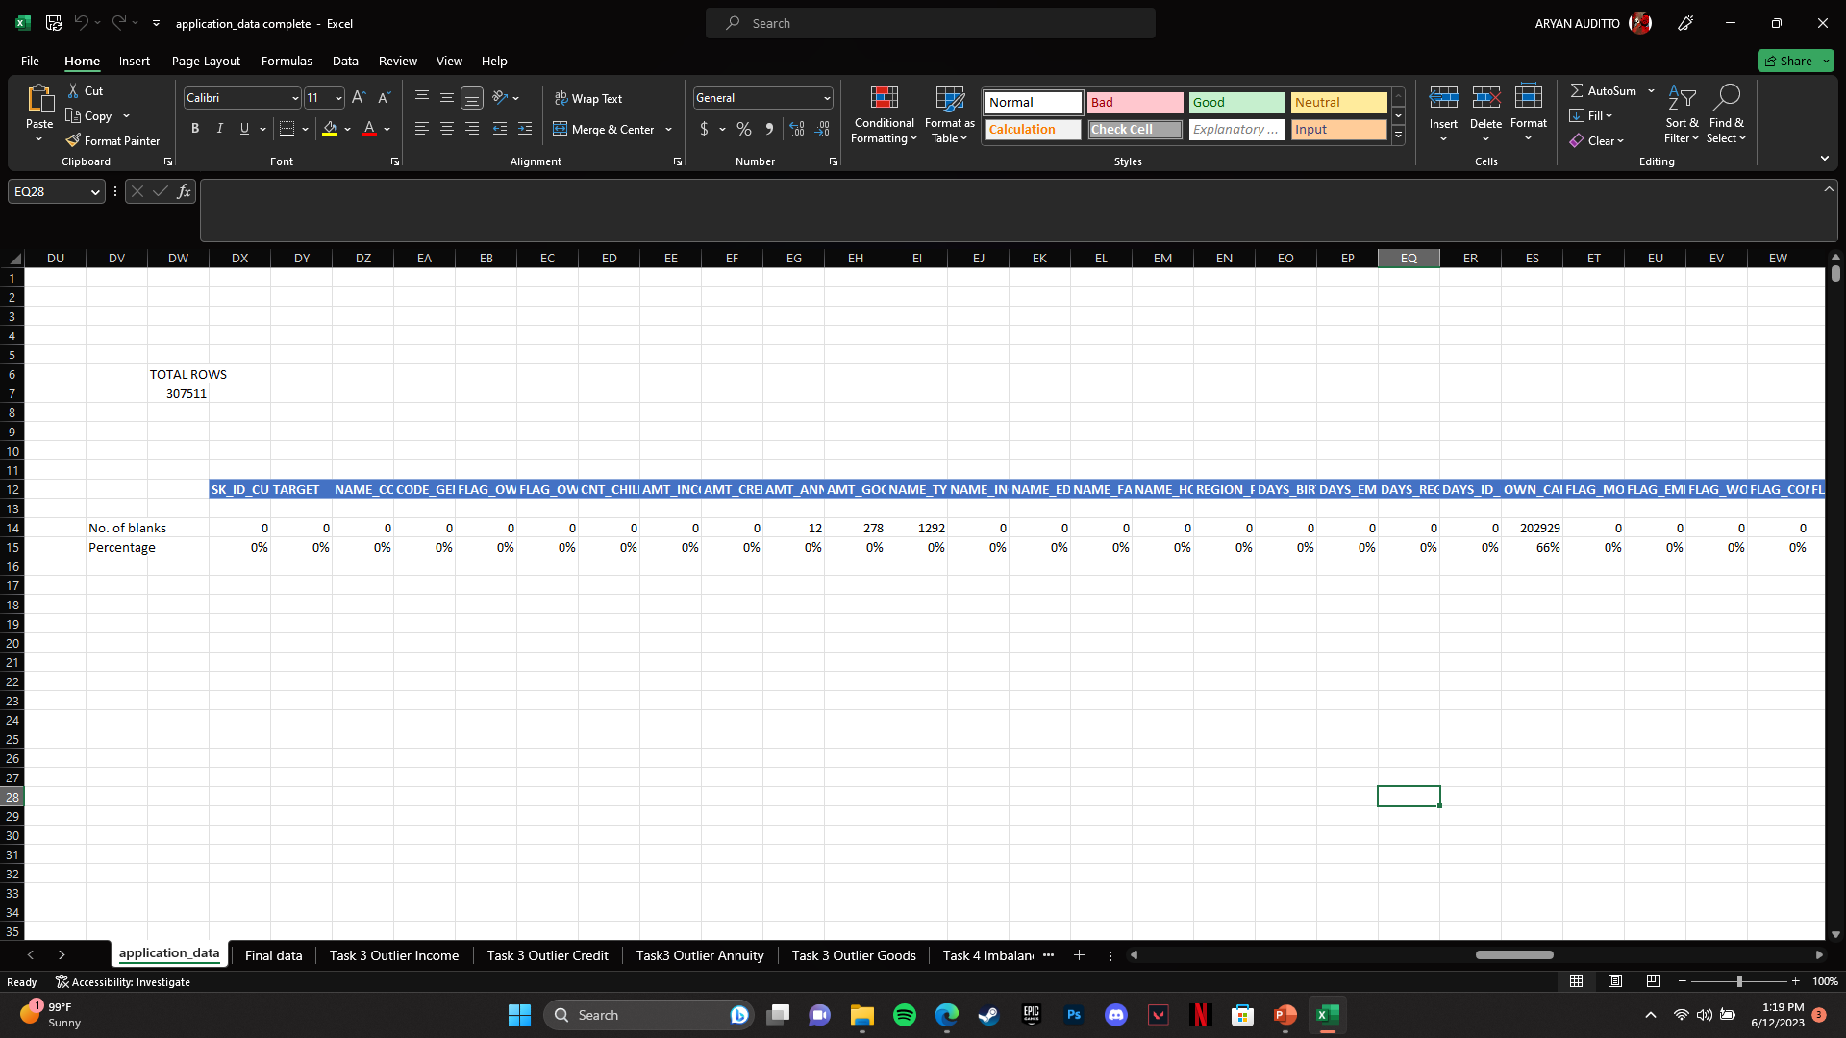
2. Find Missing Data :-
I used COUNTBLANK() Function to determine number of blanks in the given data. Then I calculated total rows and further divided the total number of blanks in each column with total number of rows.
After determining the number of blanks I removed all those columns whose percentage of null values is more than 10%
Further kept only the relevant columns required for the analysis.

Slide 7
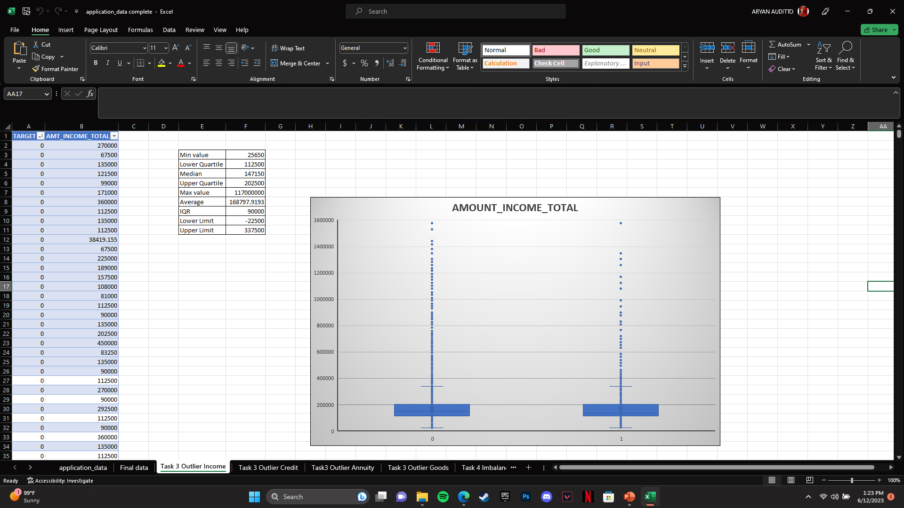
3. Outliers :-
Determined the following Outliers using Quartile function method :
TARGET VS AMOUNT INCOME TOTAL

Slide 8
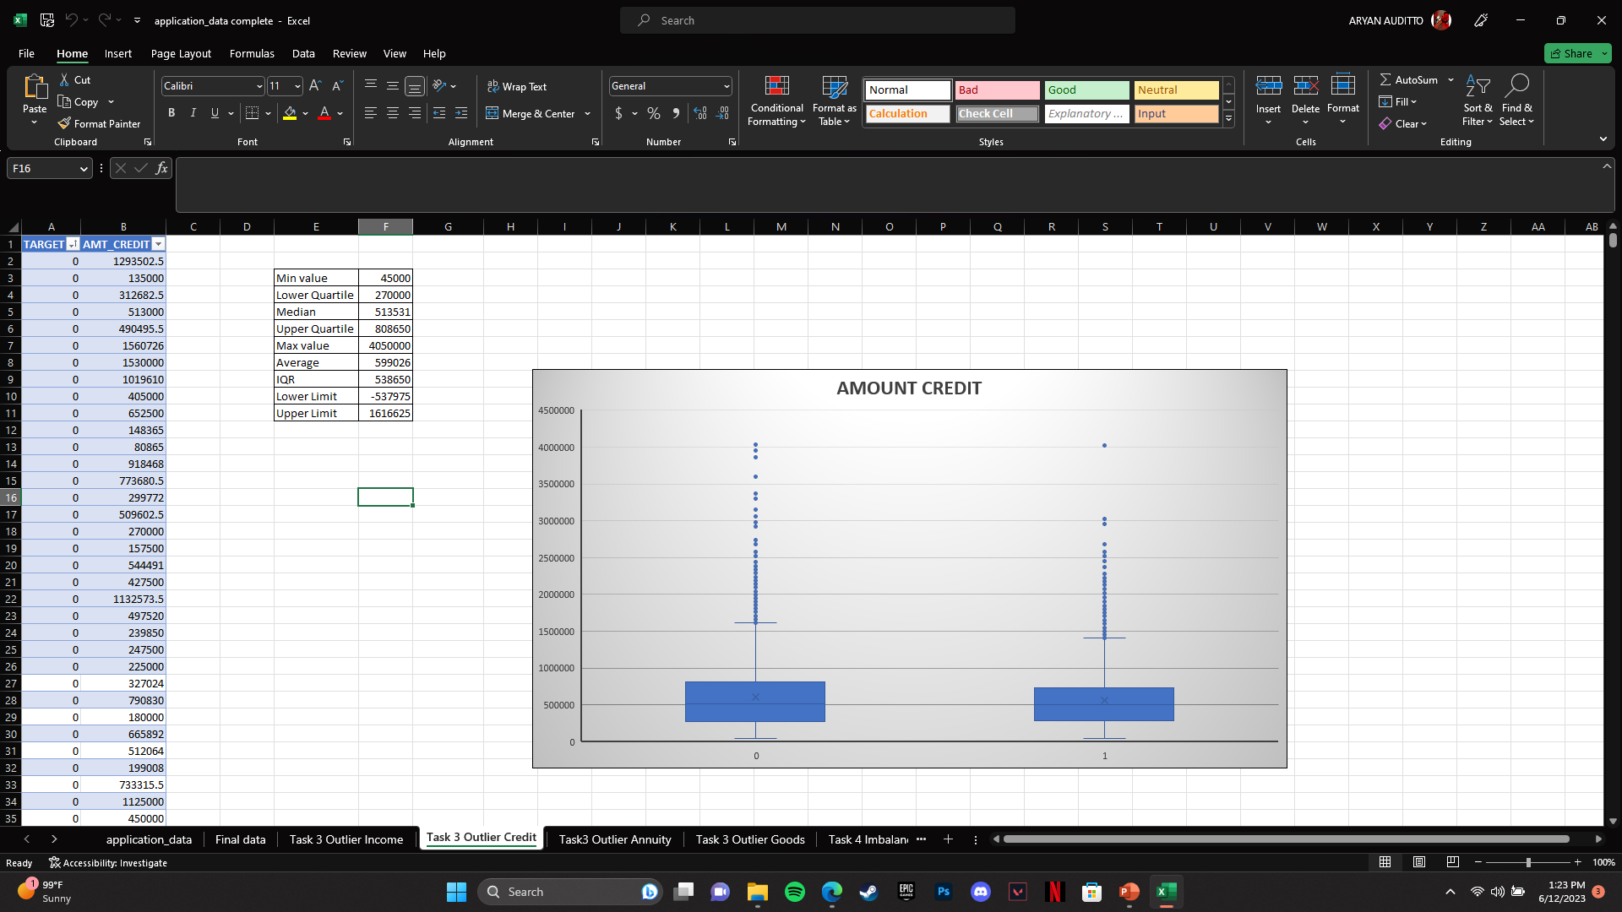
3. Outliers :-
Determined the following Outliers using Quartile function method :
TARGET VS AMOUNT CREDIT

Slide 9
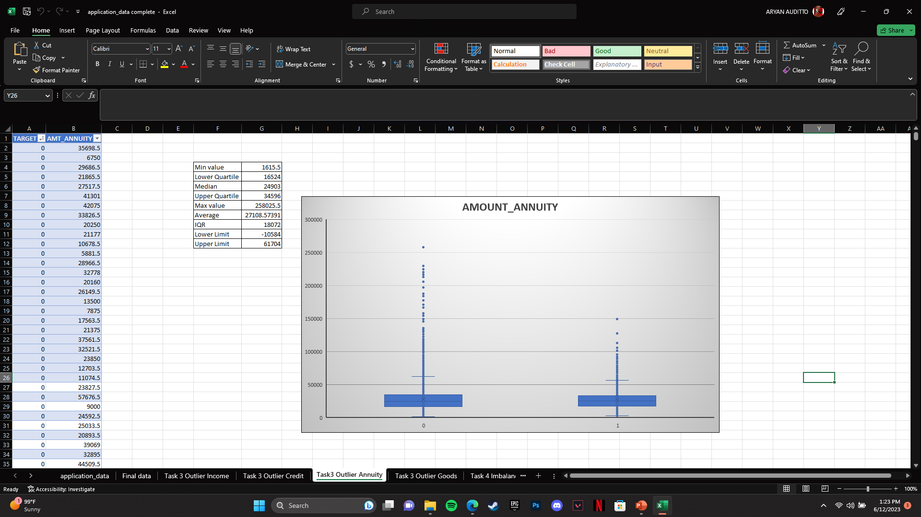
3. Outliers :-
Determined the following Outliers using Quartile function method :
TARGET VS AMOUNT ANNUITY

Slide 10
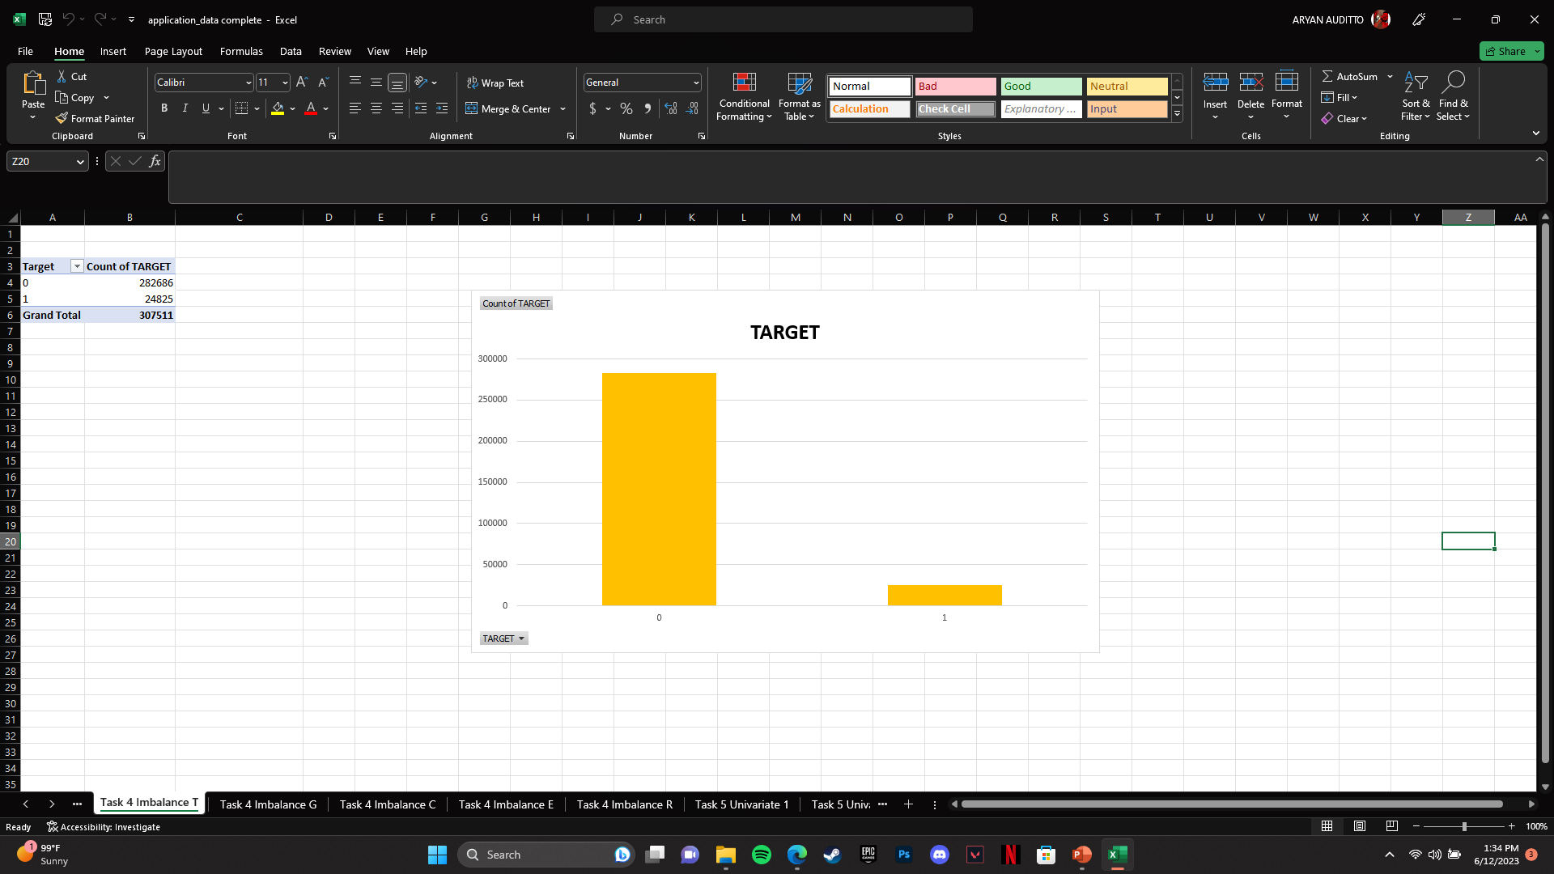
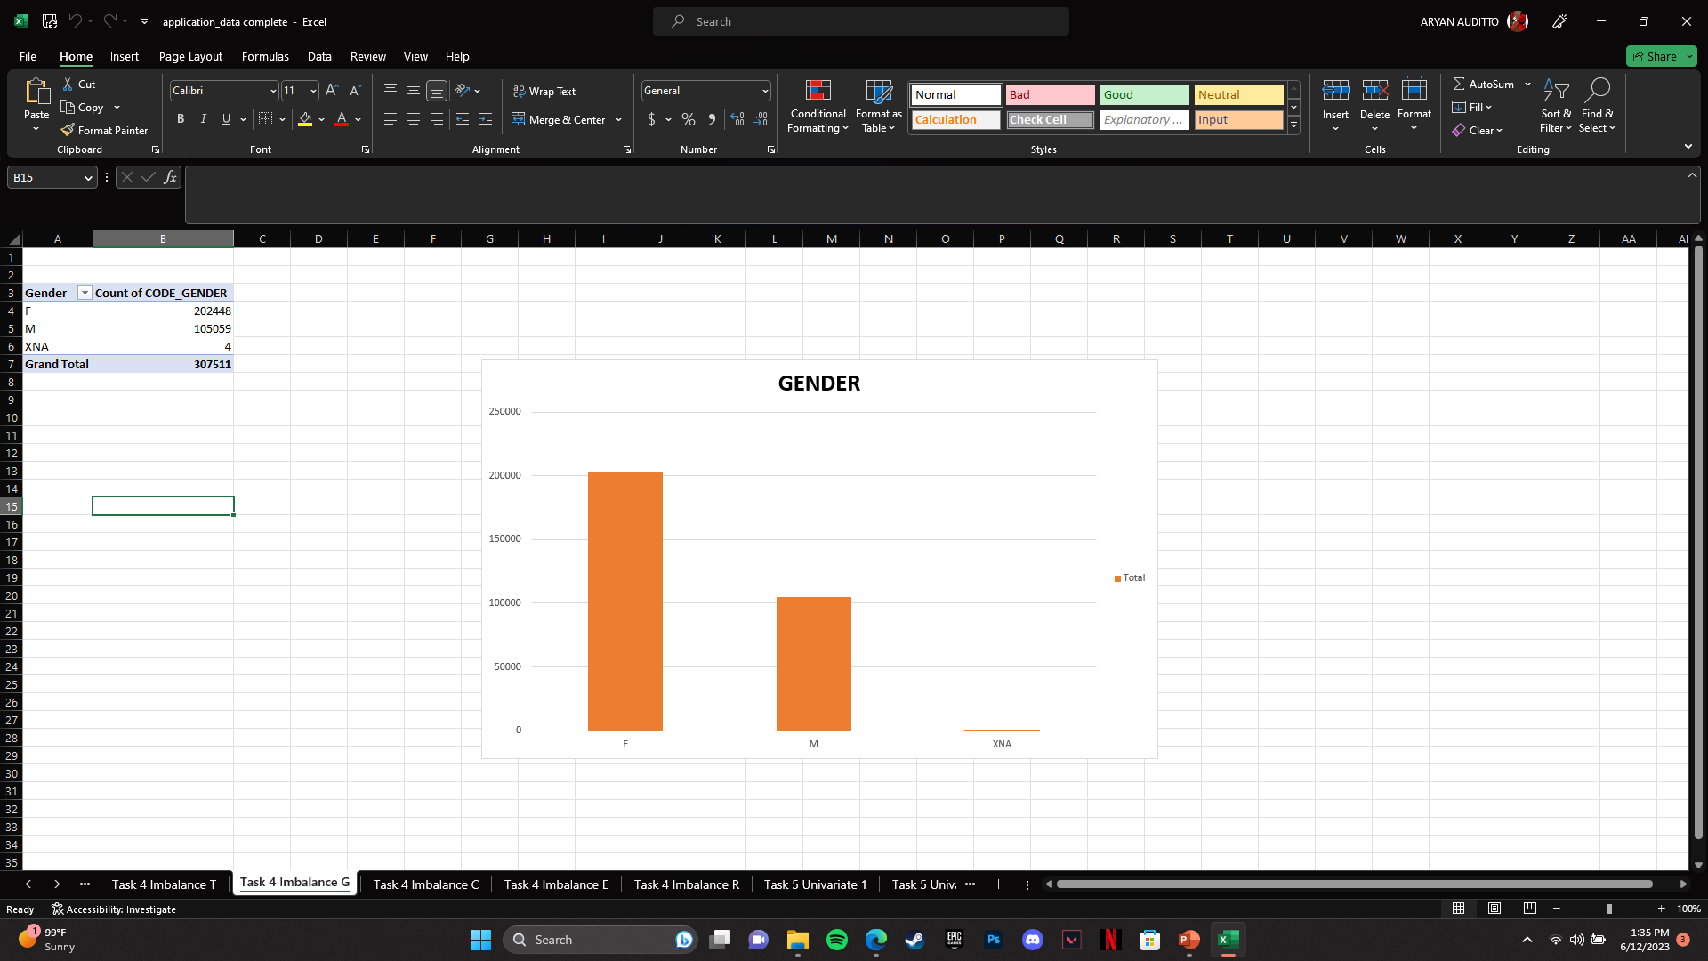
4. Data Imbalance :-
Data imbalance refers to a situation when there is an unequal representation of different classes or categories in the dataset.
Following data imbalance are determined using pivot table and visualized using pivot charts :

Slide 11
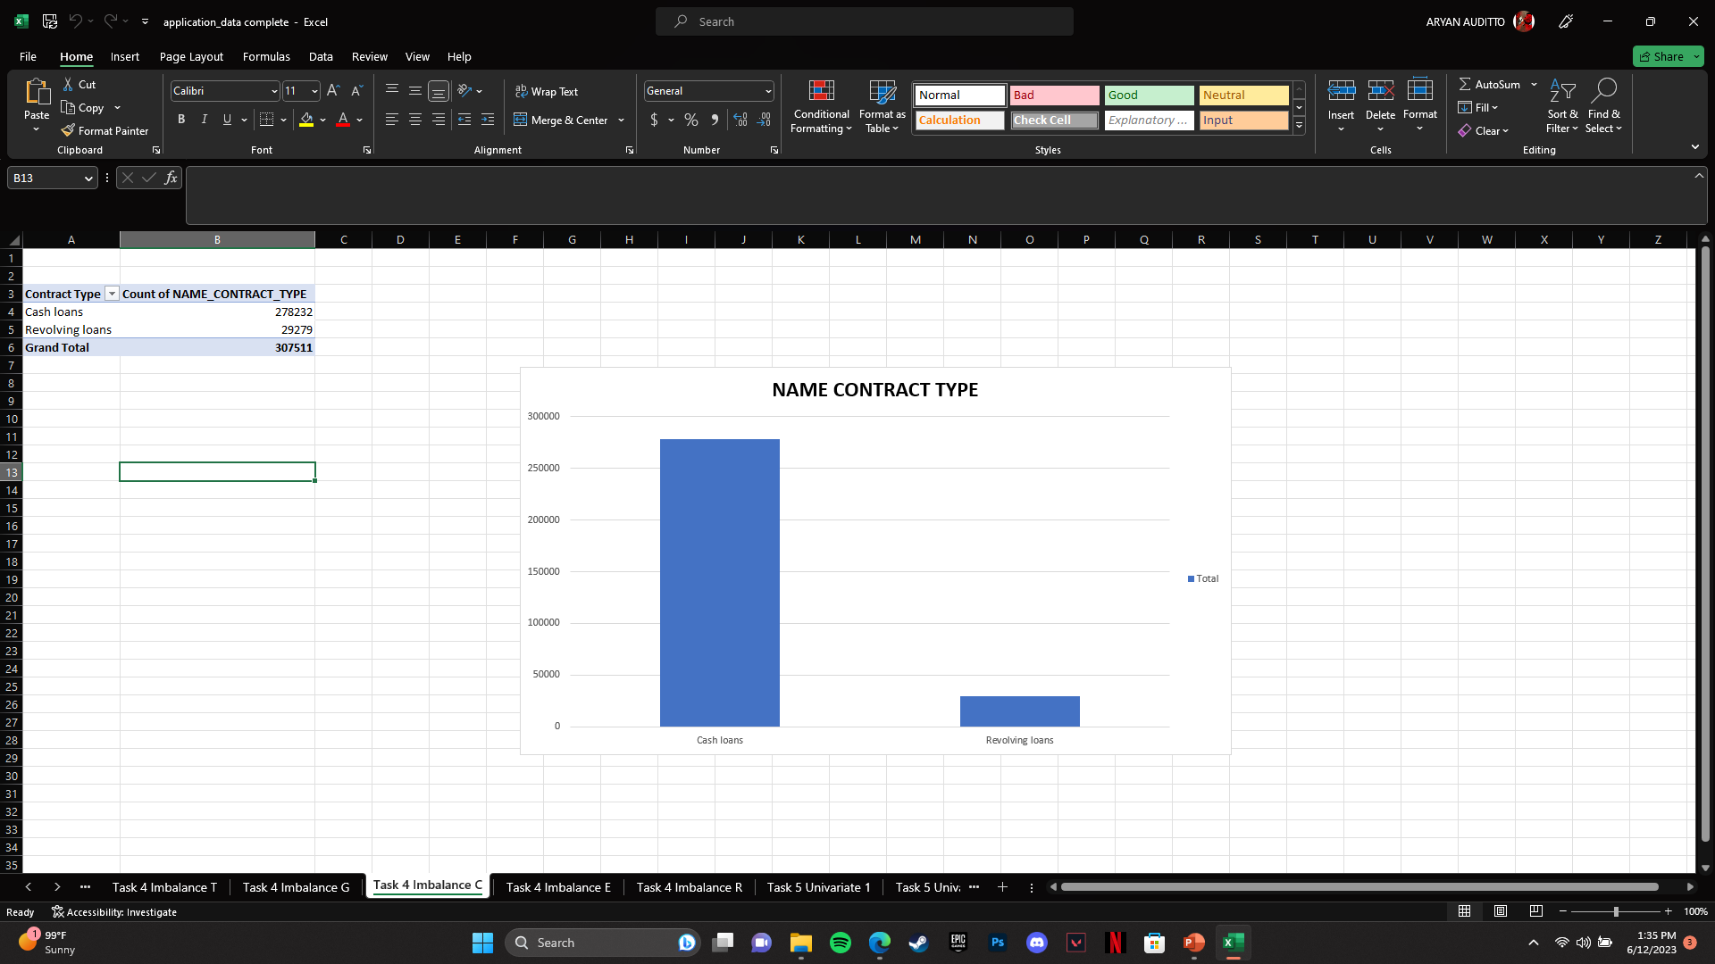
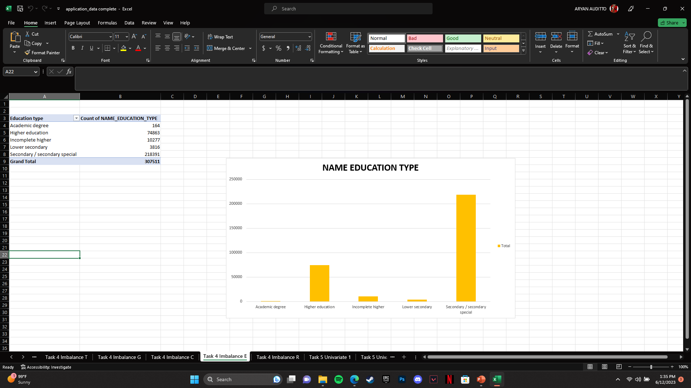
4. Data Imbalance :-
Data imbalance refers to a situation when there is an unequal representation of different classes or categories in the dataset.
Following data imbalance are determined using pivot table and visualized using pivot charts :

Slide 12
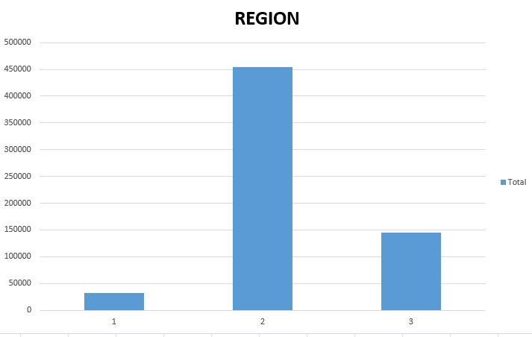
4. Data Imbalance :-
Data imbalance refers to a situation when there is an unequal representation of different classes or categories in the dataset.
Following data imbalance are determined using pivot table and visualized using pivot charts :

Slide 13
5. Univariate Analysis :-
Univariate analysis is a statistical analysis technique that focuses on examining and summarizing the characteristics and distribution of a single variable at a time. It involves analyzing and describing the data of a single variable without considering its relationship with other variables.
Following shows all the univariate analysis for application data :
Majority of credit amount of loan lies between 45000 to 1045000
Clients with lower income are shown more to apply for loan than the ones having higher income
Clients mostly under “Working” section have applied for loans followed by clients under “ Commercial Associate” and “Pensioner” section.
Statistically people who got married have applied for more loans as compared others.
People who own House/Apartment are way likely to apply for loans as compared to others.
Clients who have been employed with experience of 0-5 years period are more likely to apply for loans.

Slide 14
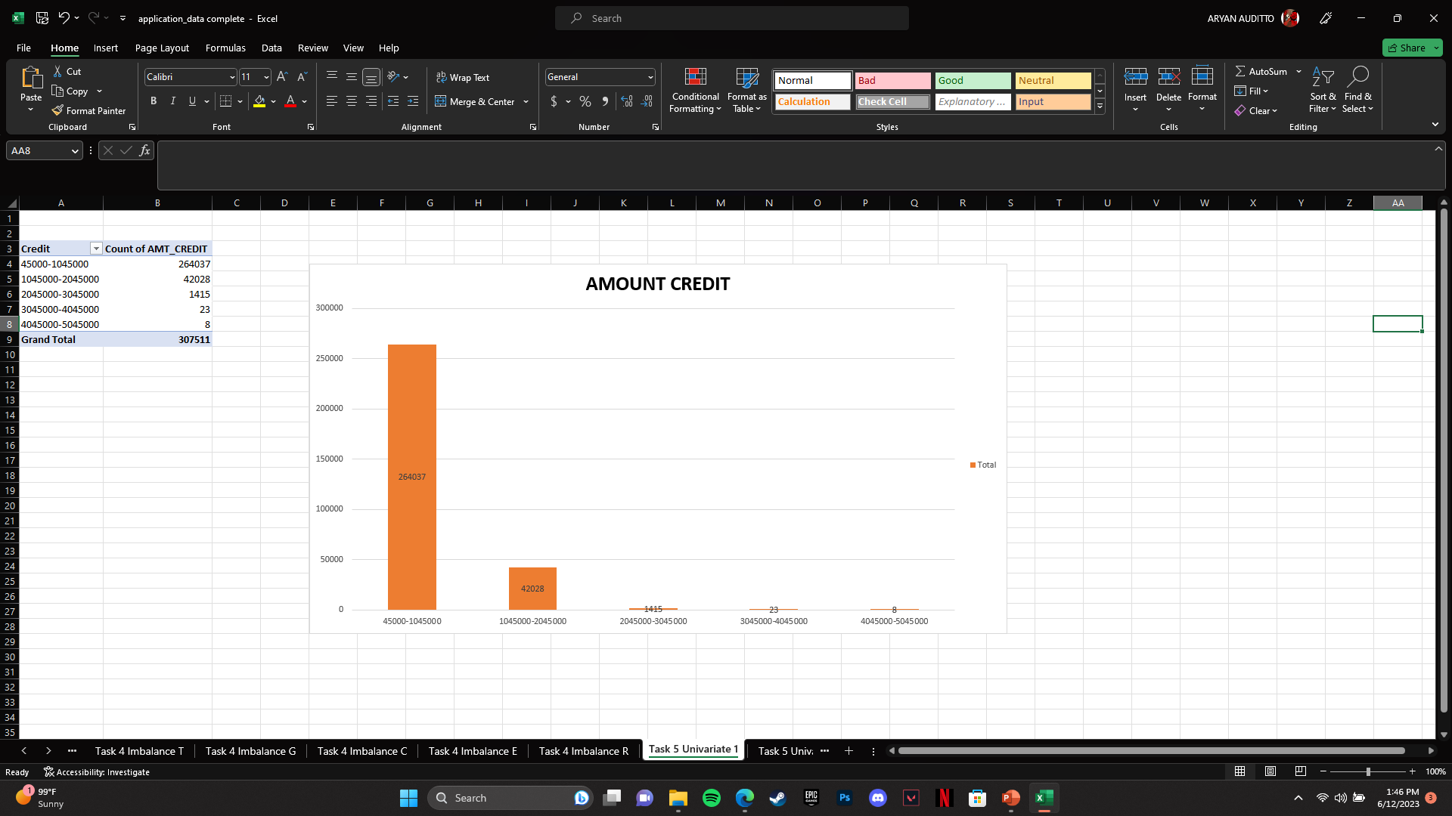
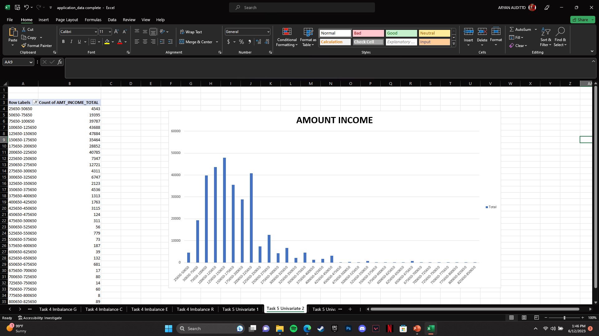
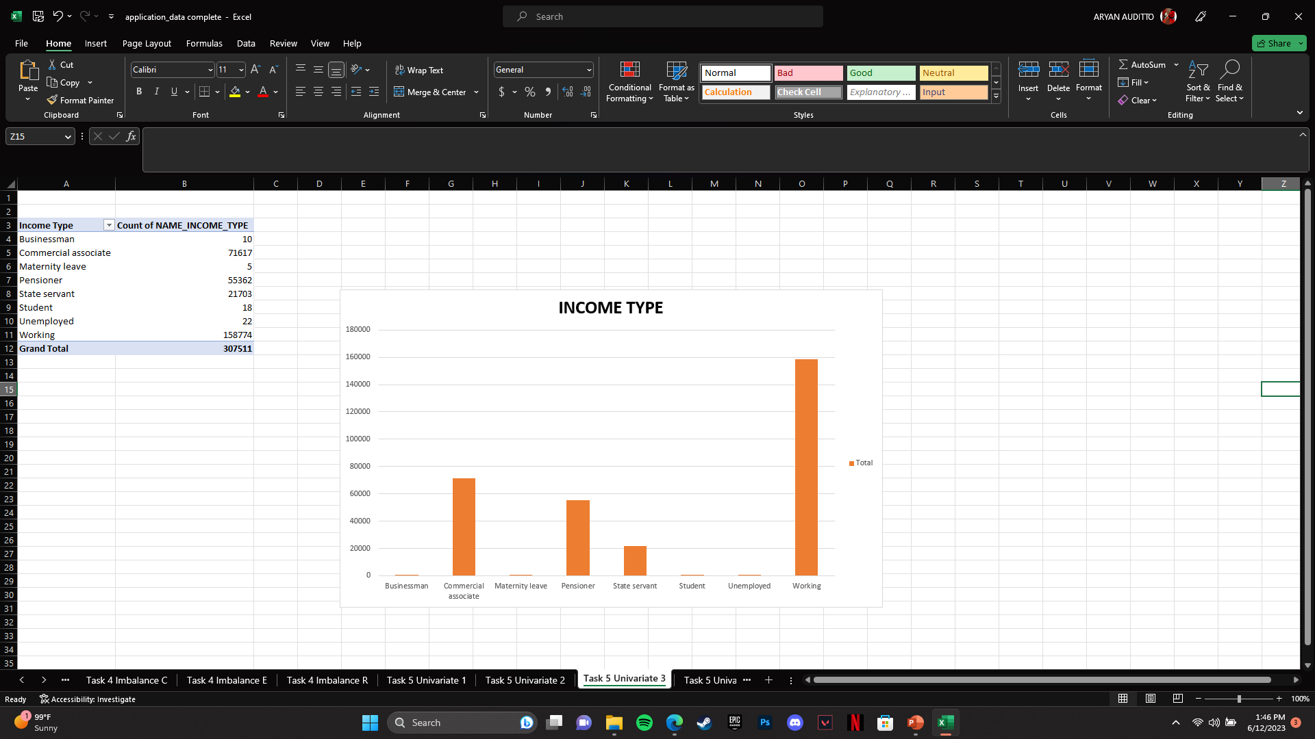
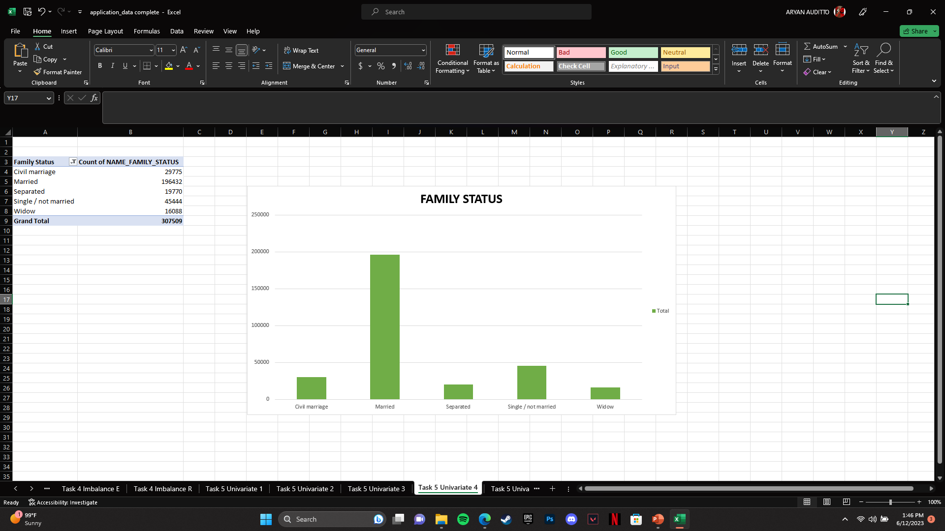
5. Univariate Analysis :-

Slide 15
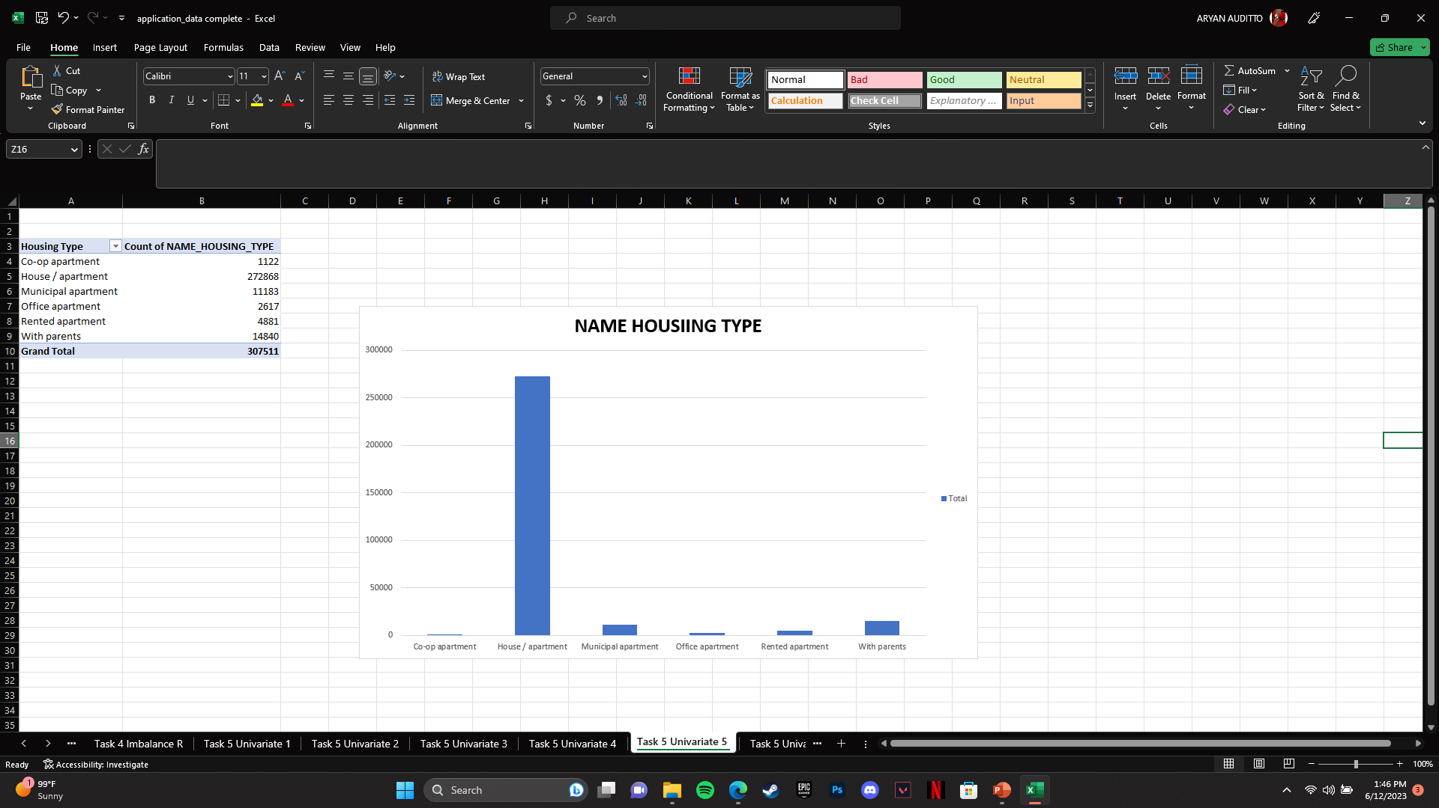
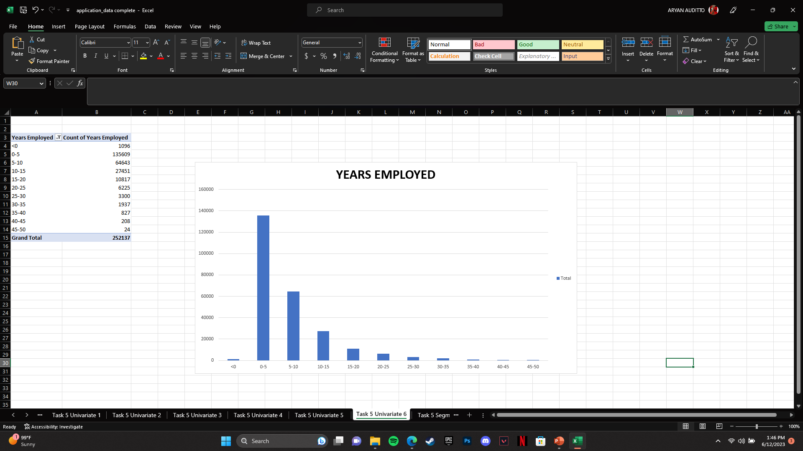
5. Univariate Analysis :-

Slide 16
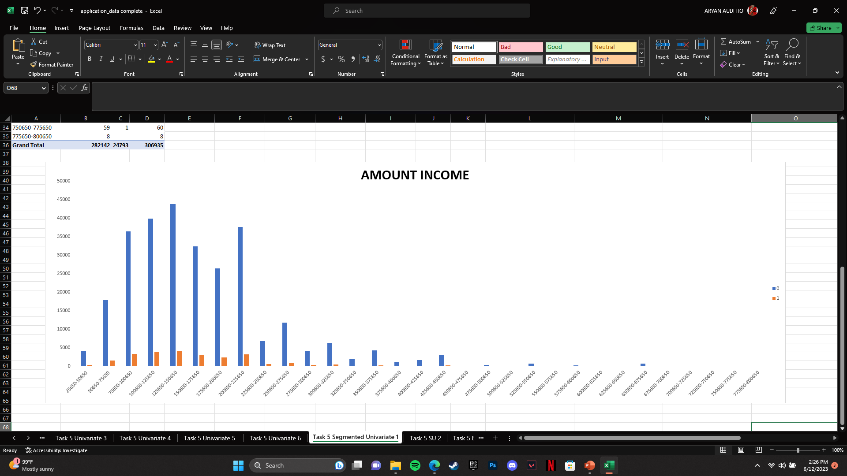
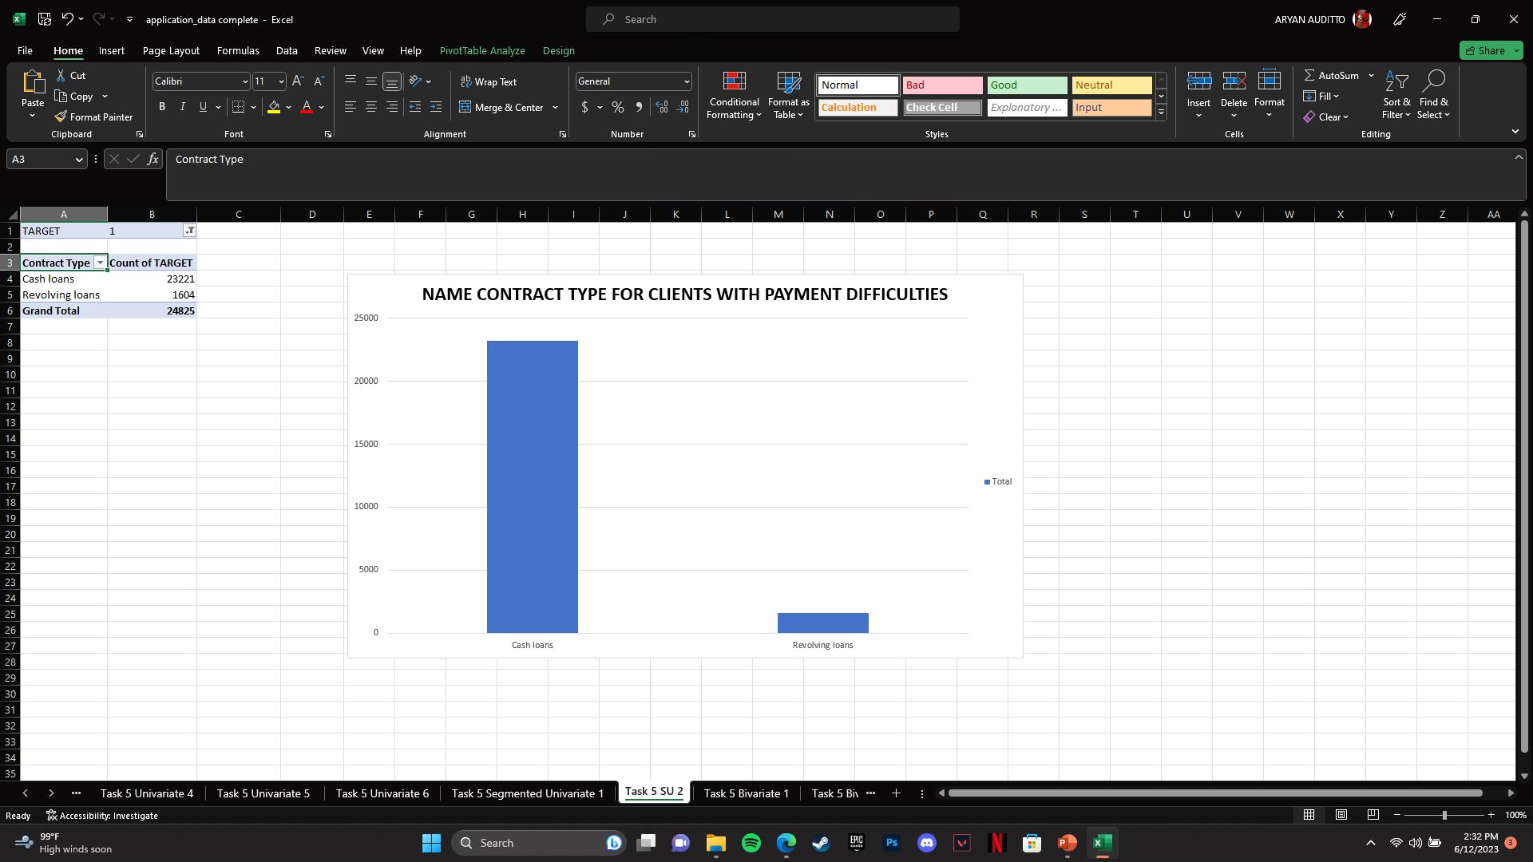
5. Segmented Univariate Analysis :-
Segmented univariate analysis is a technique in data analysis where the dataset is divided into distinct segments or groups based on a single variable, and separate univariate analysis is performed on each segment.
Following shows all the Segmented univariate analysis for application data :
Majority of the clients have an income in range between 75000-250000. Clients with more than 500000 income are very less likely to apply for loans.
Cash loans are much likely to get default with client having payment difficulties.

Slide 17
5. Bivariate Analysis :-
Bivariate analysis determining the relationship between two variables. It focuses on understanding how changes in one variable are associated with changes in another variable.
Following shows all the Bivariate analysis for application data :
In the gender section, Female clients have been shown to have lower chance of defaults as compared to men.
Clients with Secondary/Secondary special are likely to have defaults as compared to other education qualifications.
Clients who own House/Apartment are more likely toh have their loans default than others.
Clients under “ Working” Section are more inclined towards defaults as compared to others.

Slide 18
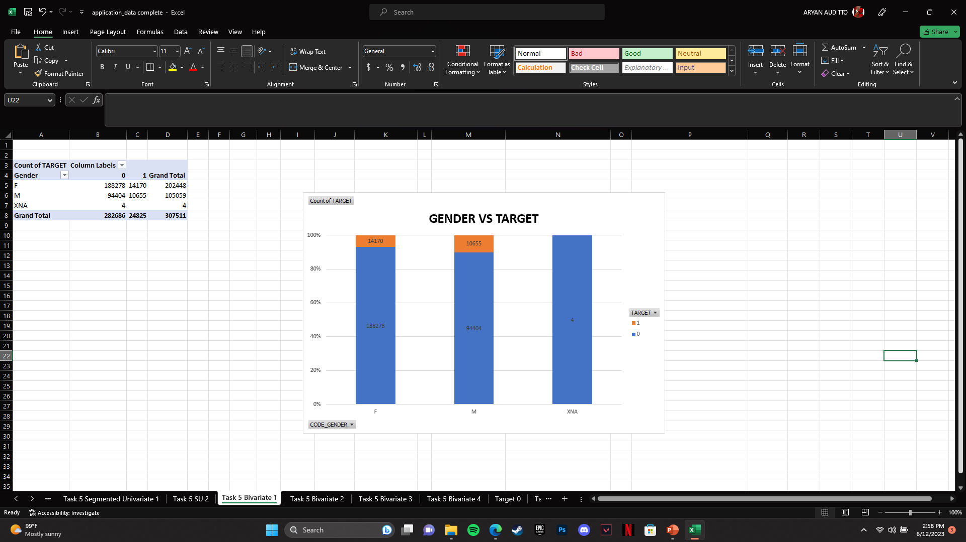
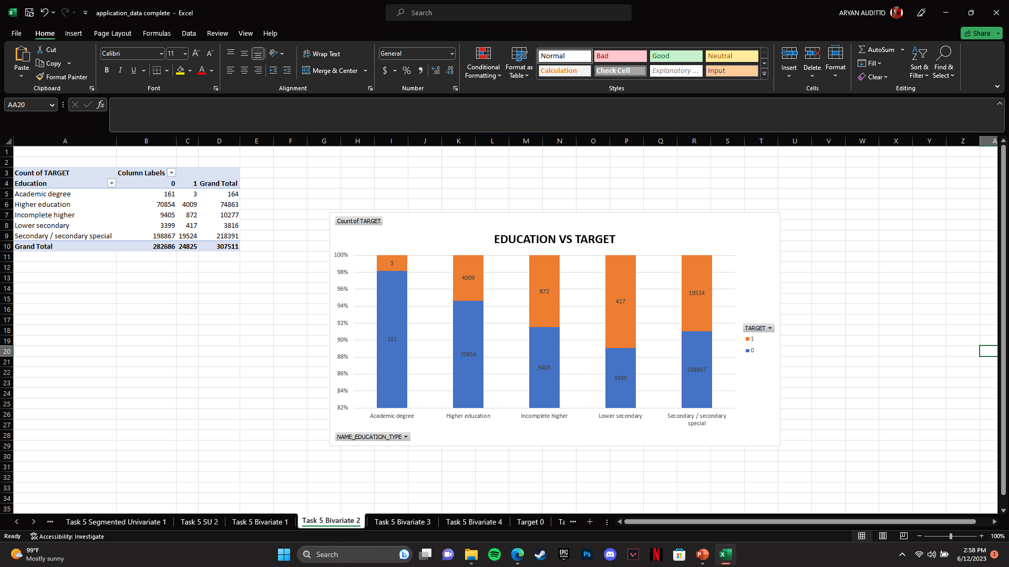
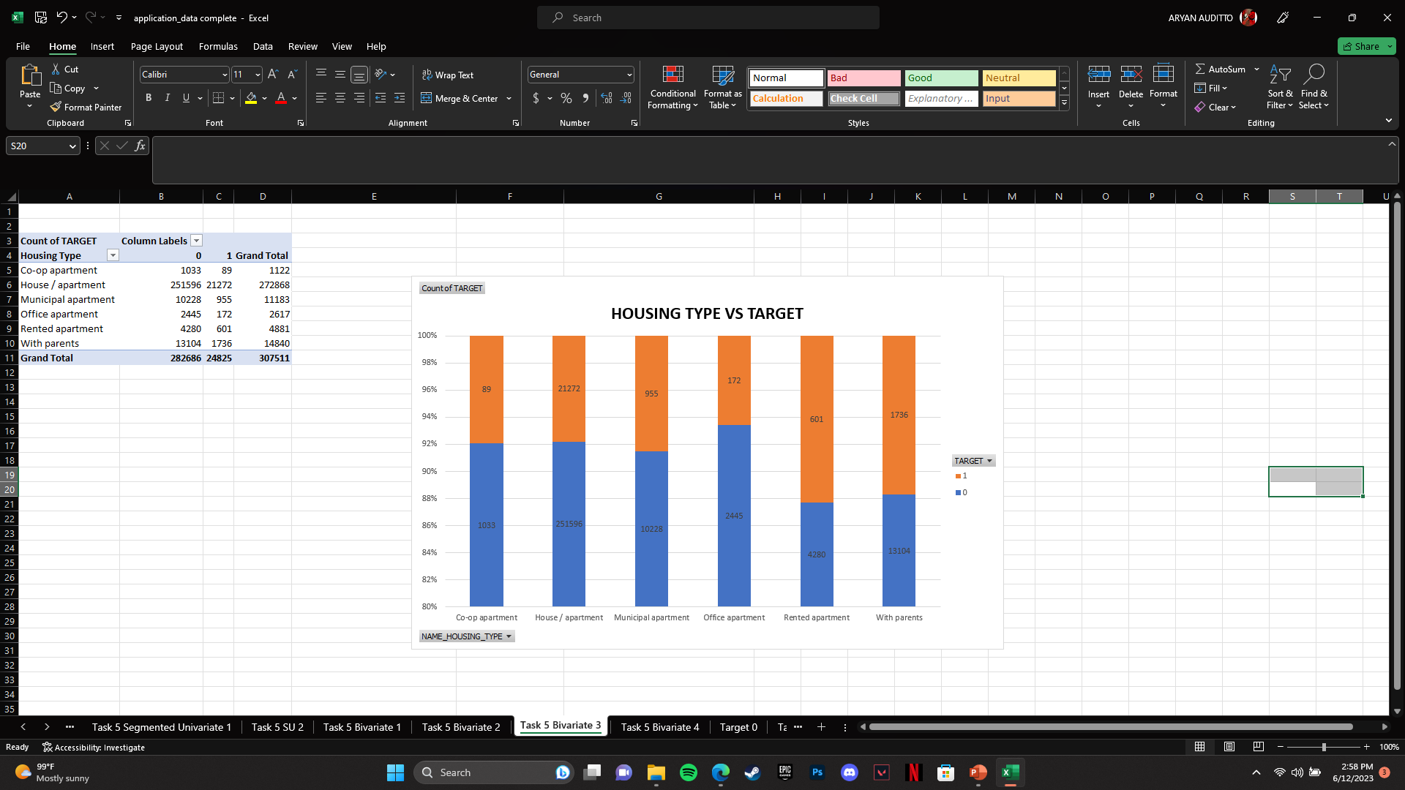
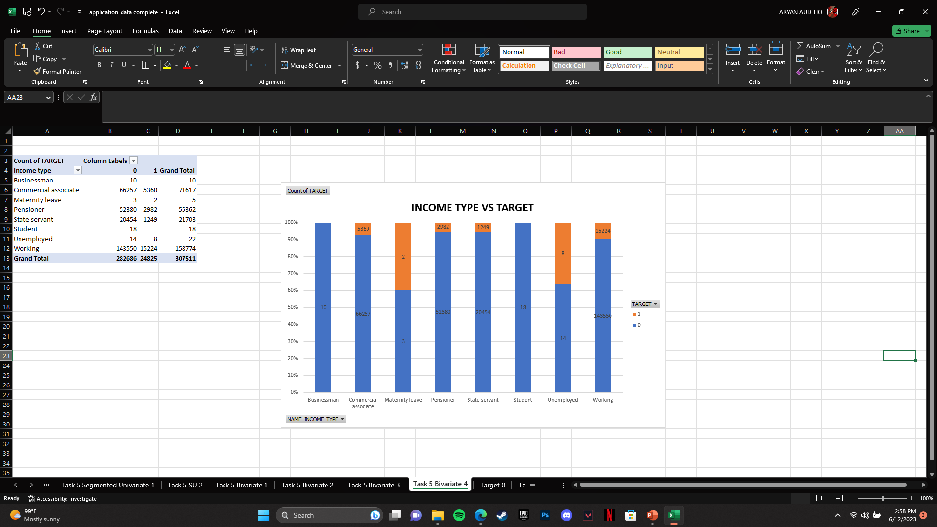
5. Bivariate Analysis :-

Slide 19
6. Correlation :-
Correlation determines the relationship or association between two variables. It indicates the extent to which changes in one variable are related to changes in another variable. Correlation is used to determine the direction (positive or negative) and strength of the relationship between the variables.
Following are top 10 correlation for client with payment difficulties and other cases using CORREL() FUNTION :
Count Children
Total Income amount
Amount Credit
Amount Annuity
Amount Goods Price
Region Population Relative
Count Family Members
Region Rating Client
External Source
Years Employed

Slide 20
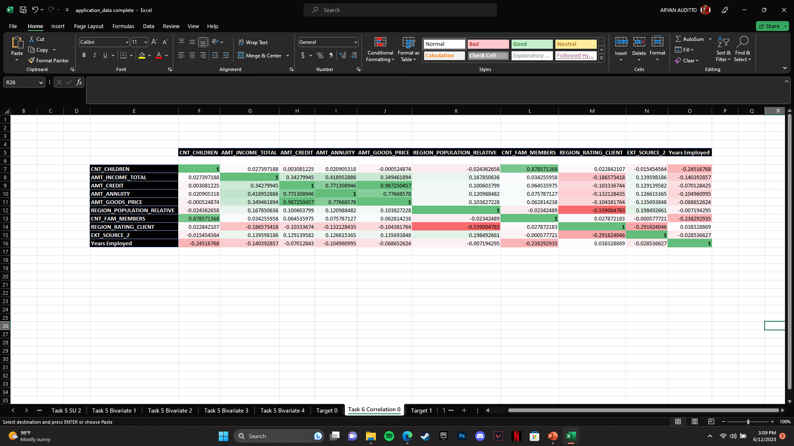
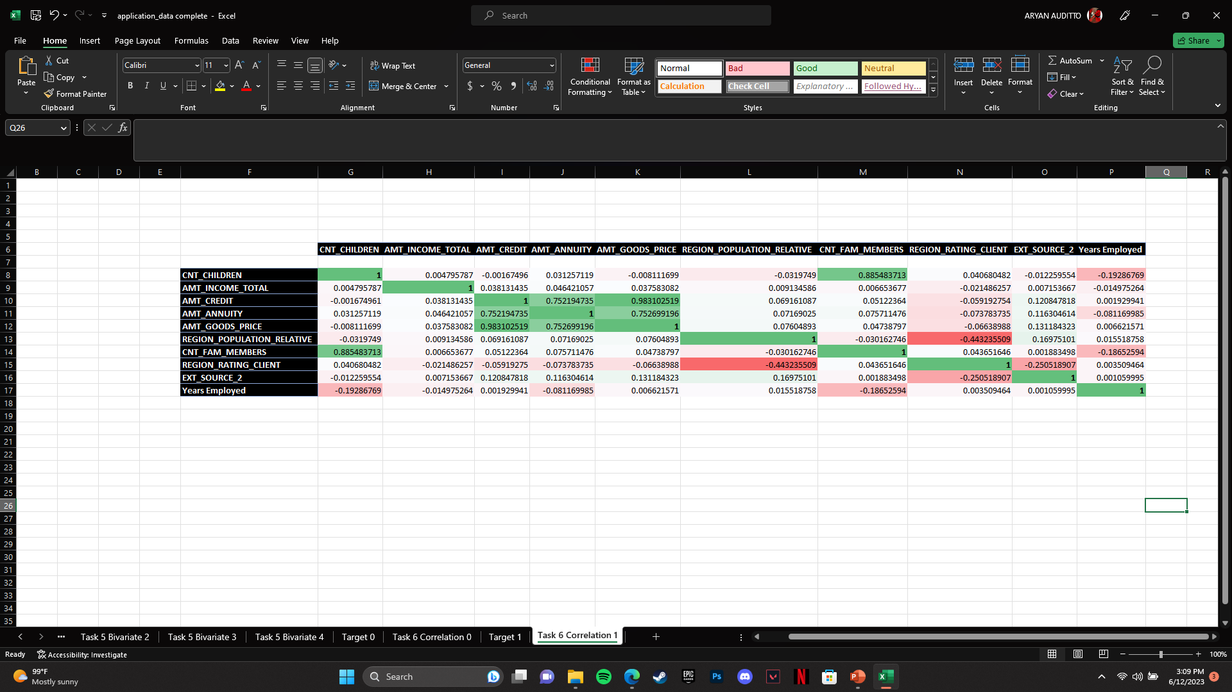
6. Correlation :-
Conditional formatting to determine correlation for target 0
Conditional formatting to determine correlation for target 1

Slide 21
PREVIOUS_APPLICATION
Hyperlink for working file :- Previous_Application Complete
NOTE: Working files have been uploaded to google drive due to limit exceed
All the tasks are performed in this working file and each task is divided into separate sheets

Slide 22
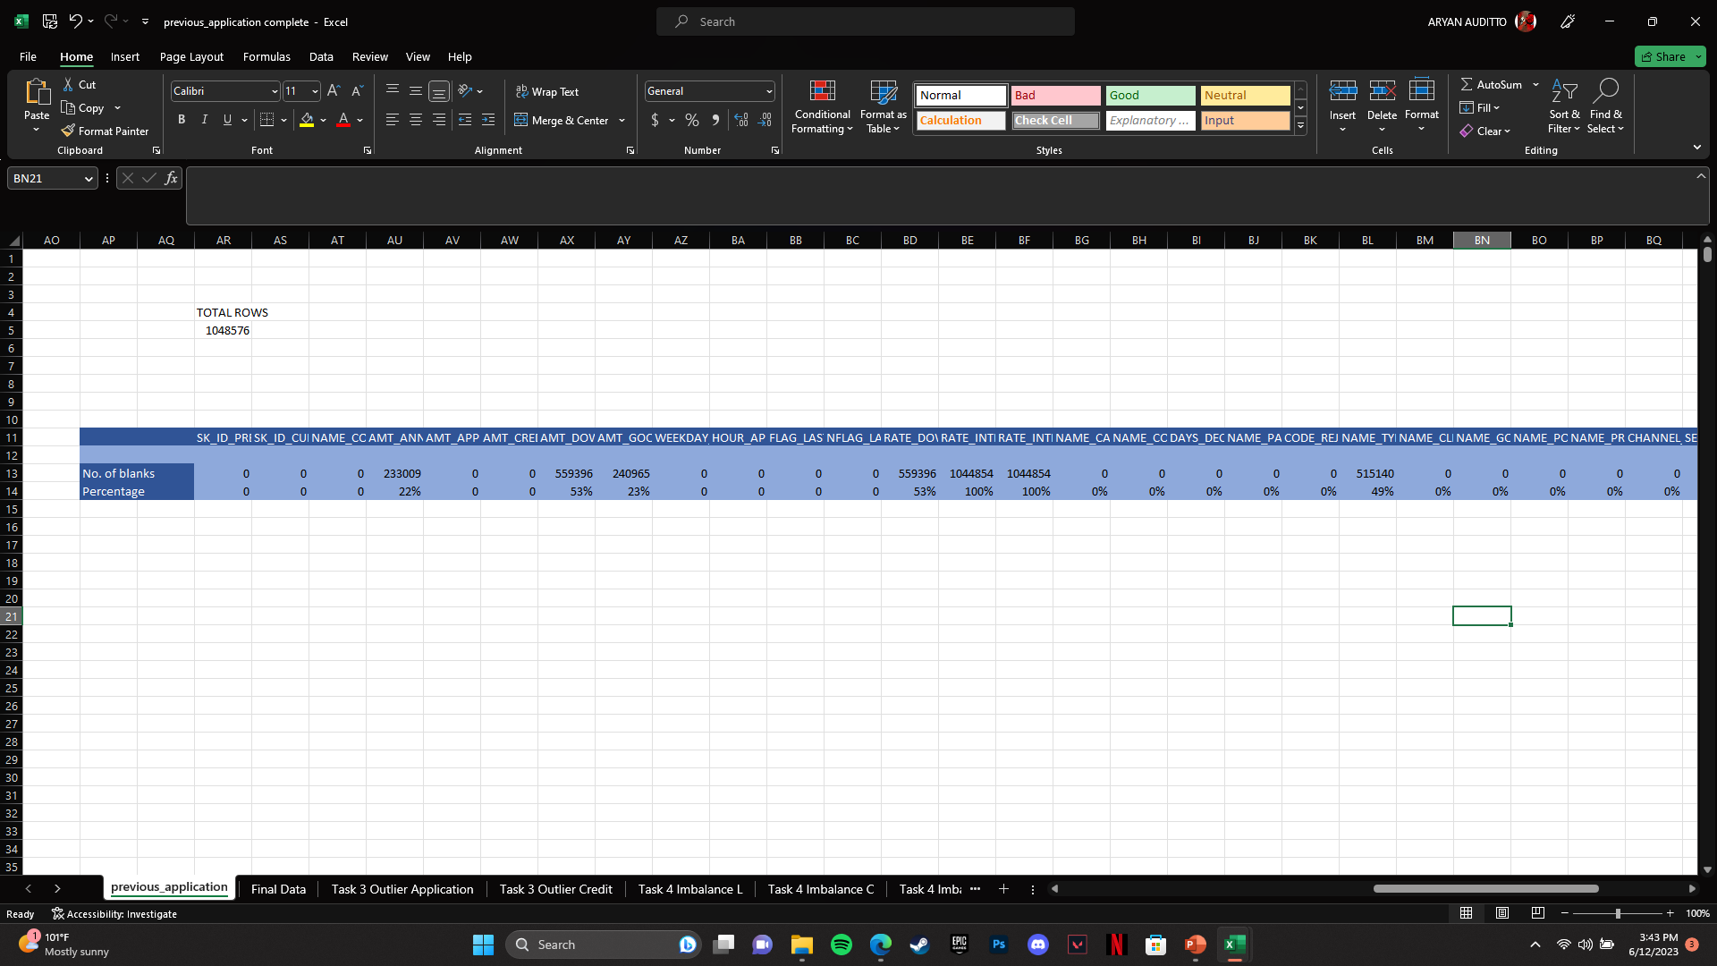
2. Find Missing Data :-
I used COUNTBLANK() Function to determine number of blanks in the given data. Then I calculated total rows and further divided the total number of blanks in each column with total number of rows.
After determining the number of blanks I removed all those columns whose percentage of null values is more than 10%
Further kept only the relevant columns required for the analysis.

Slide 23
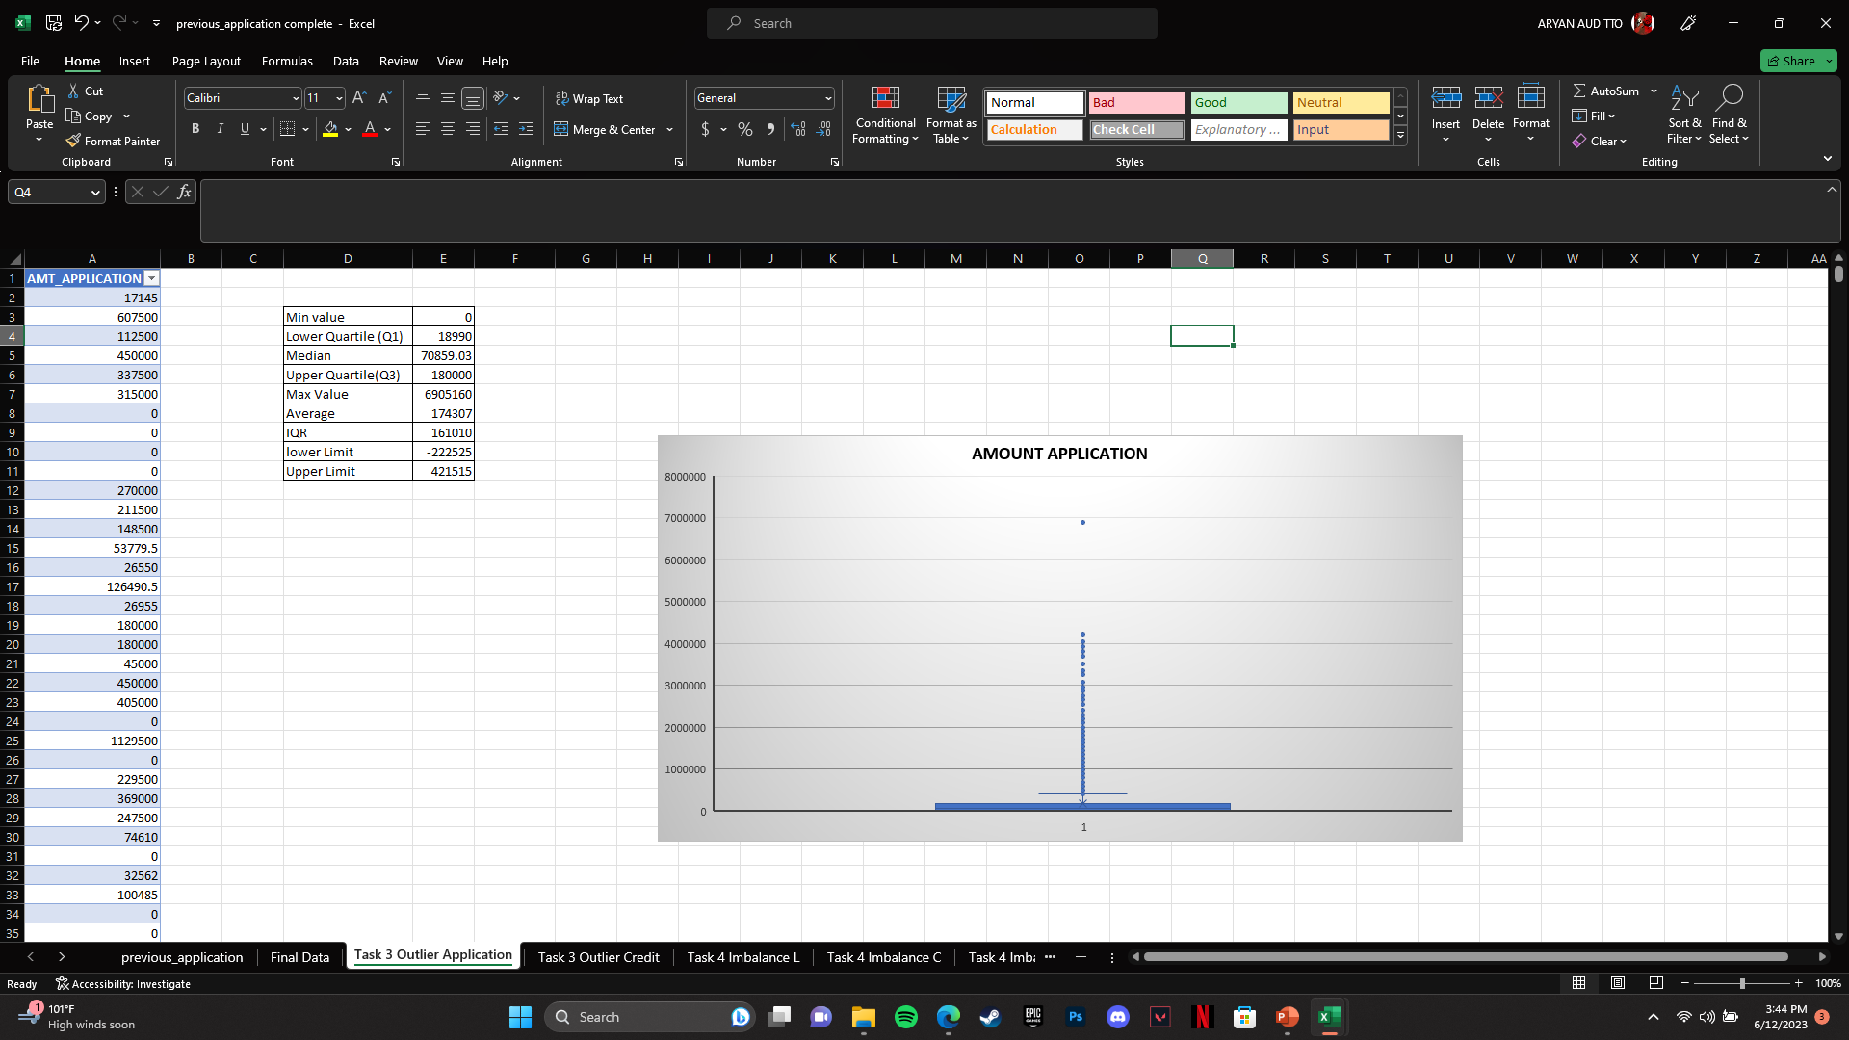
3. Outliers :-
Determined the following Outliers using Quartile function method :

Slide 24
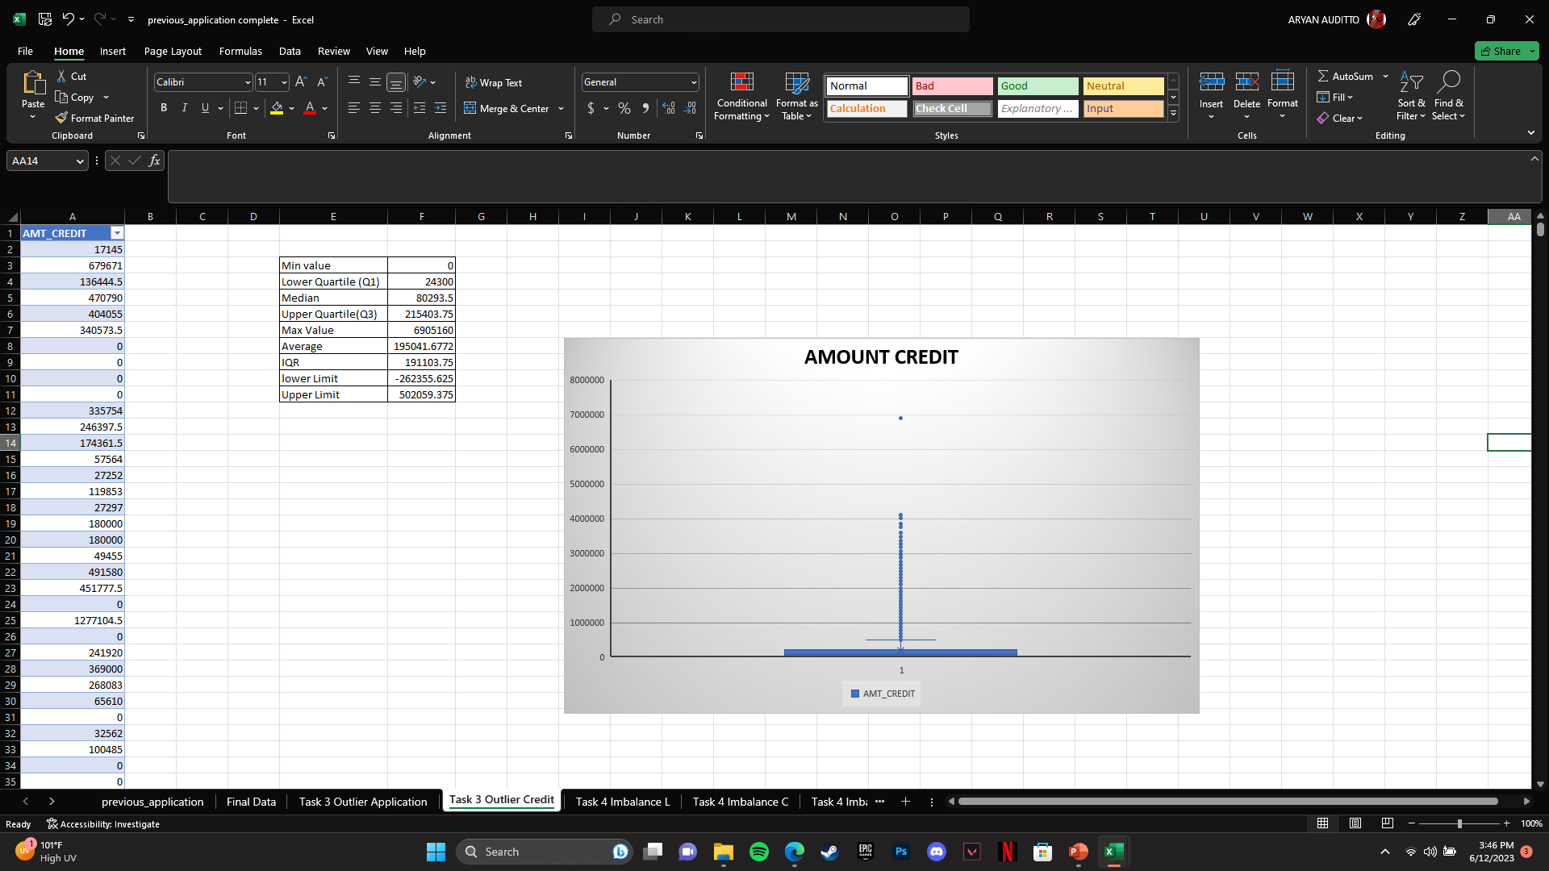
3. Outliers :-
Determined the following Outliers using Quartile function method :

Slide 25
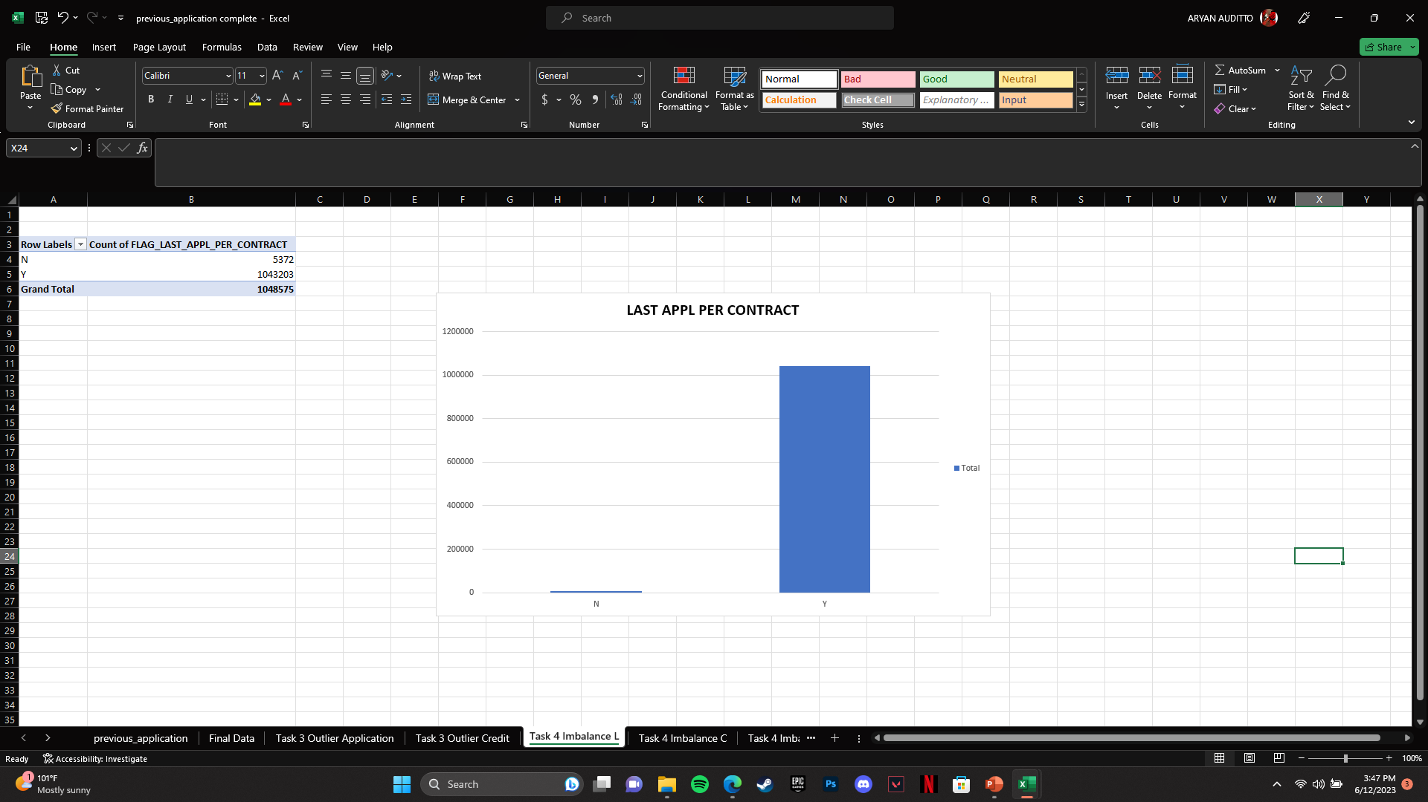
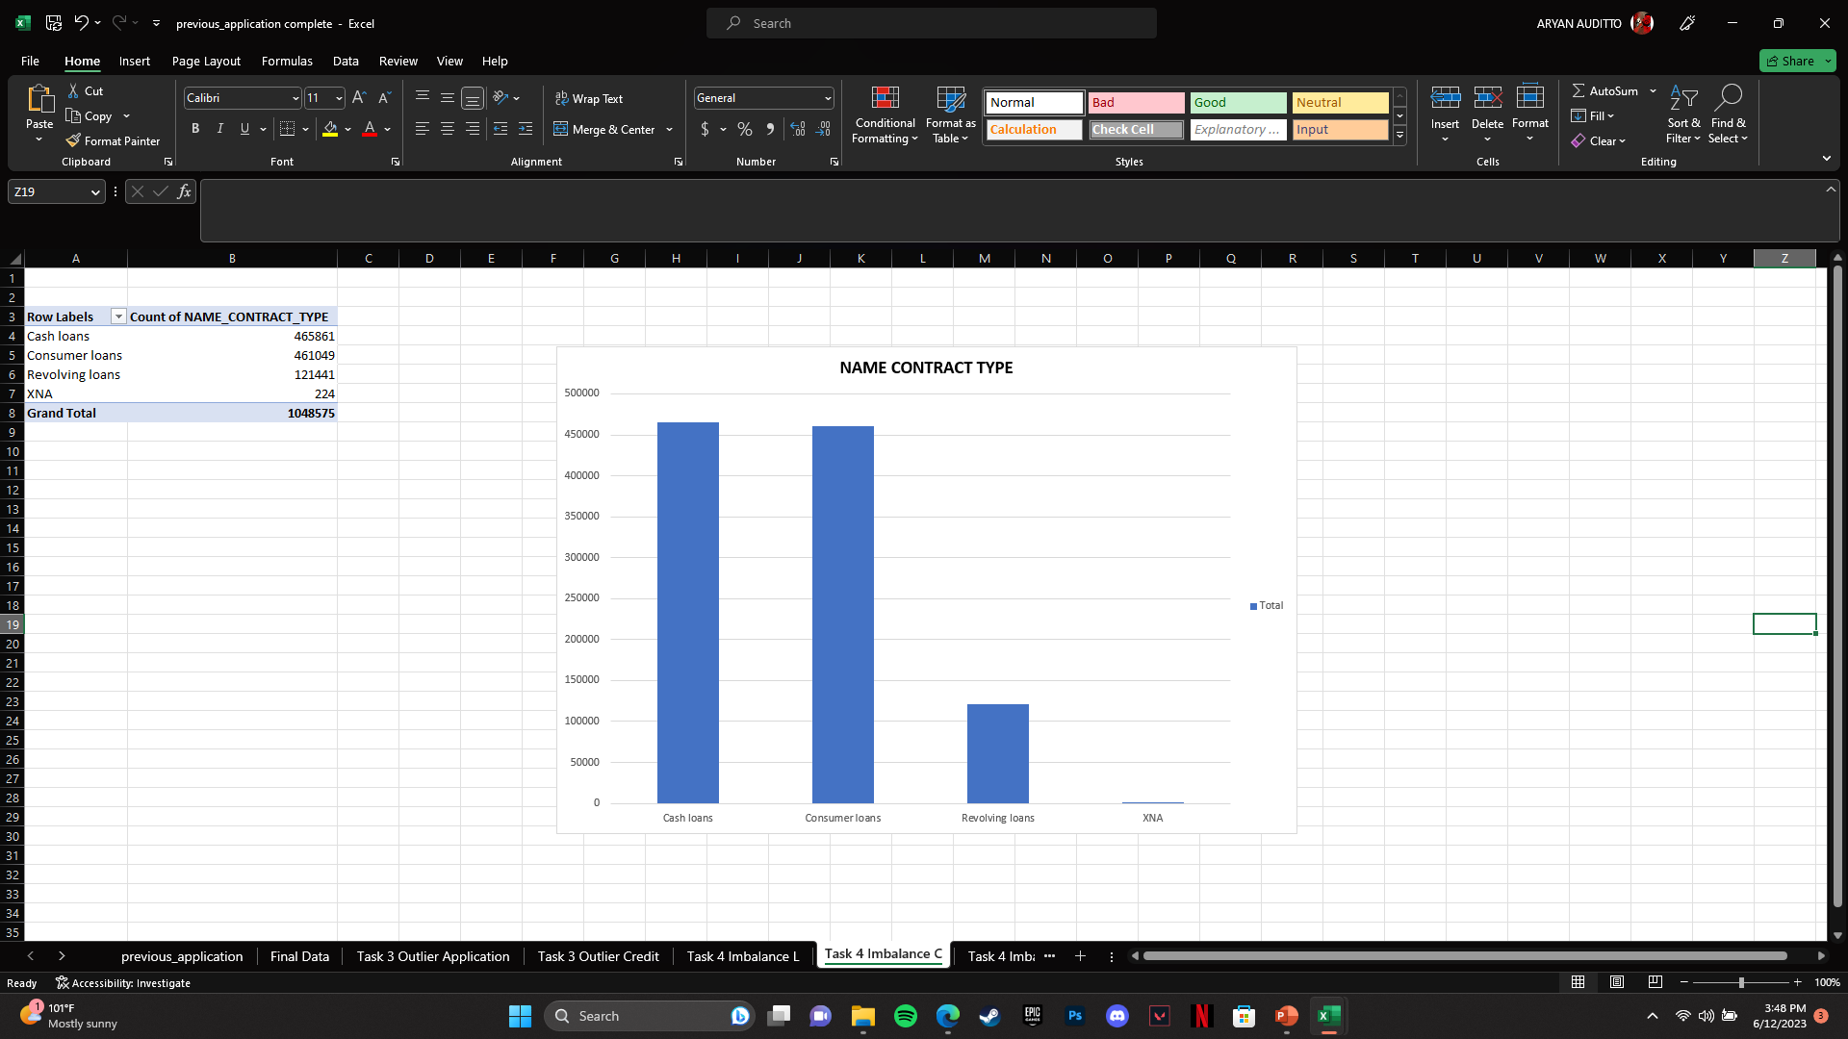
4. Data Imbalance :-
Data imbalance refers to a situation when there is an unequal representation of different classes or categories in the dataset.
Following data imbalance are determined using pivot table and visualized using pivot charts :

Slide 26
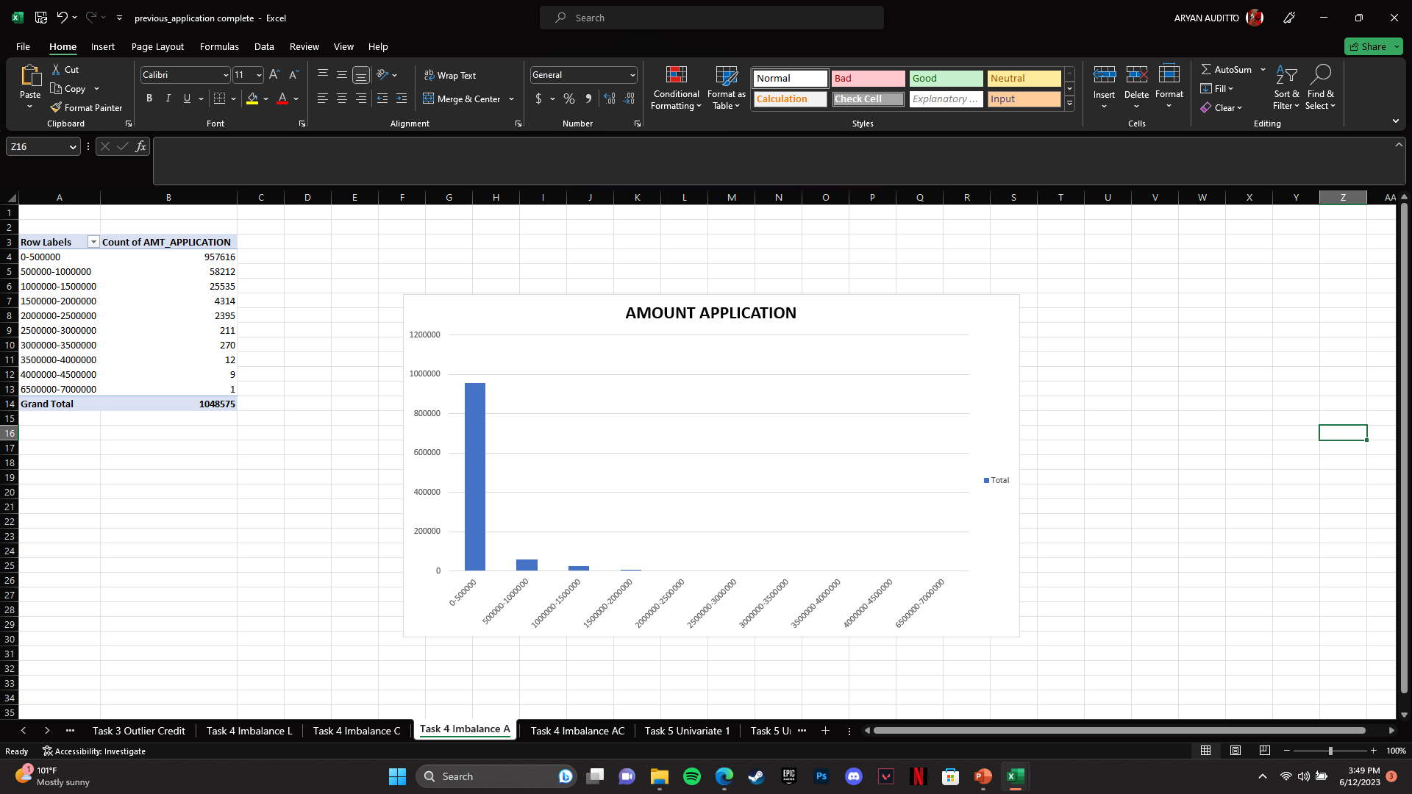
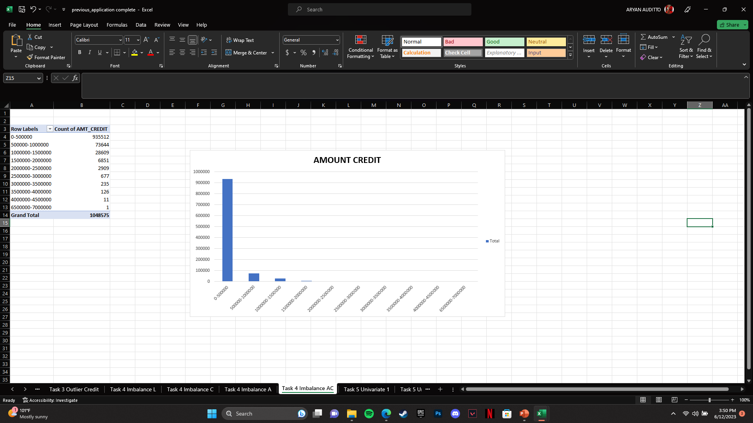
4. Data Imbalance :-
Data imbalance refers to a situation when there is an unequal representation of different classes or categories in the dataset.
Following data imbalance are determined using pivot table and visualized using pivot charts :

Slide 27
5. Univariate Analysis :-
Univariate analysis is a statistical analysis technique that focuses on examining and summarizing the characteristics and distribution of a single variable at a time. It involves analyzing and describing the data of a single variable without considering its relationship with other variables.
Following shows all the univariate analysis for application data :
Majority of amount clients applied for ranges in between 0 - 500000
Majority of the clients lie under “Repeater” Classification.
Most of the clients have applied for more than one application in a day.
Majority of loans are approved for payment under cash through the bank.

Slide 28
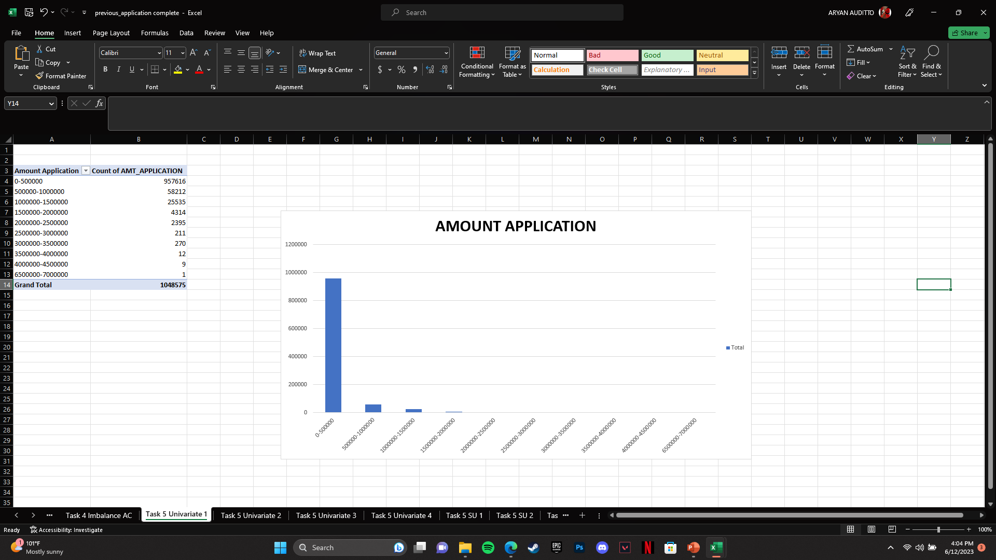
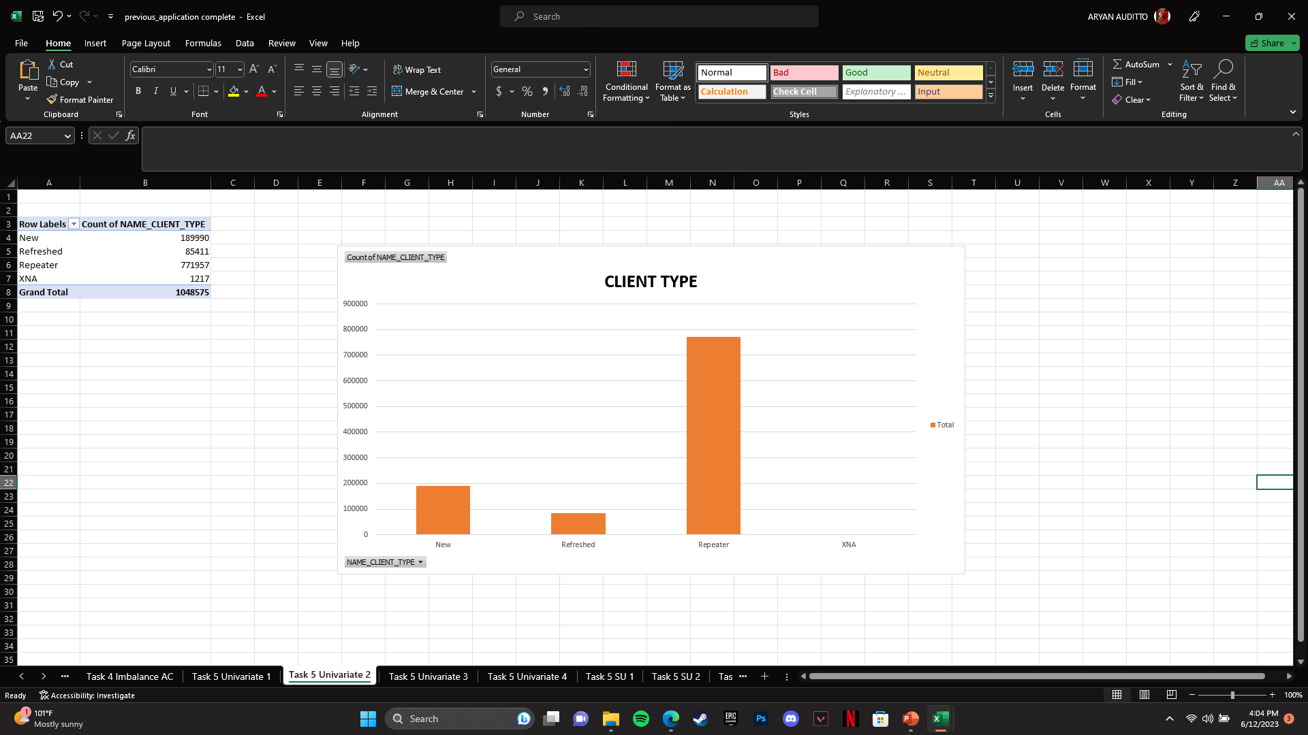
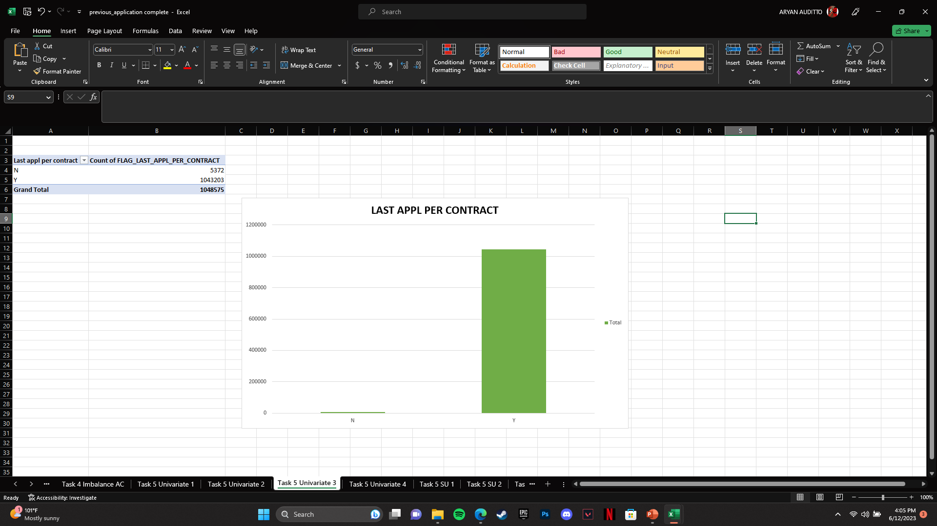
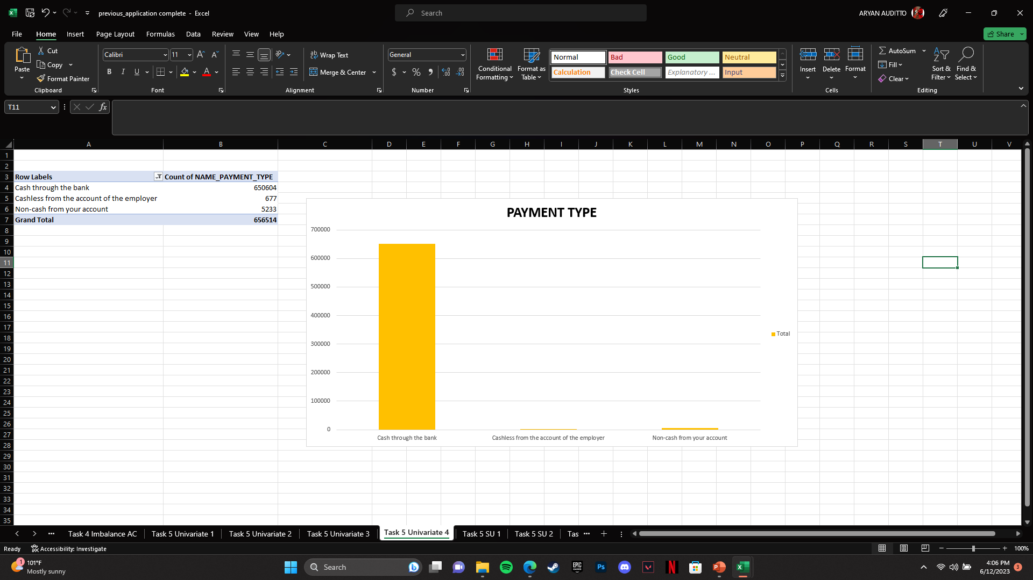
5. Univariate Analysis :-

Slide 29
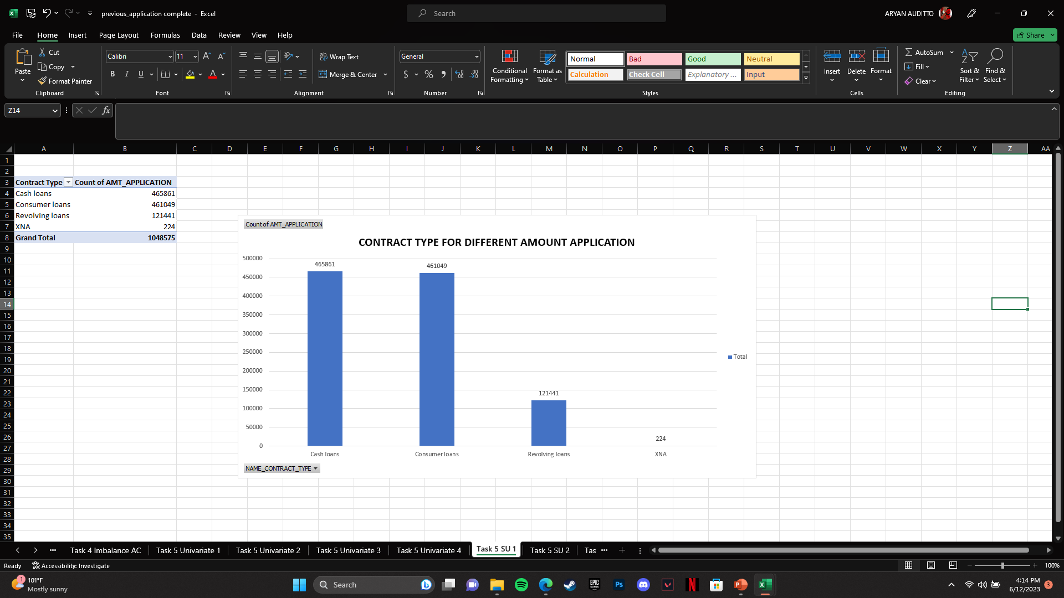
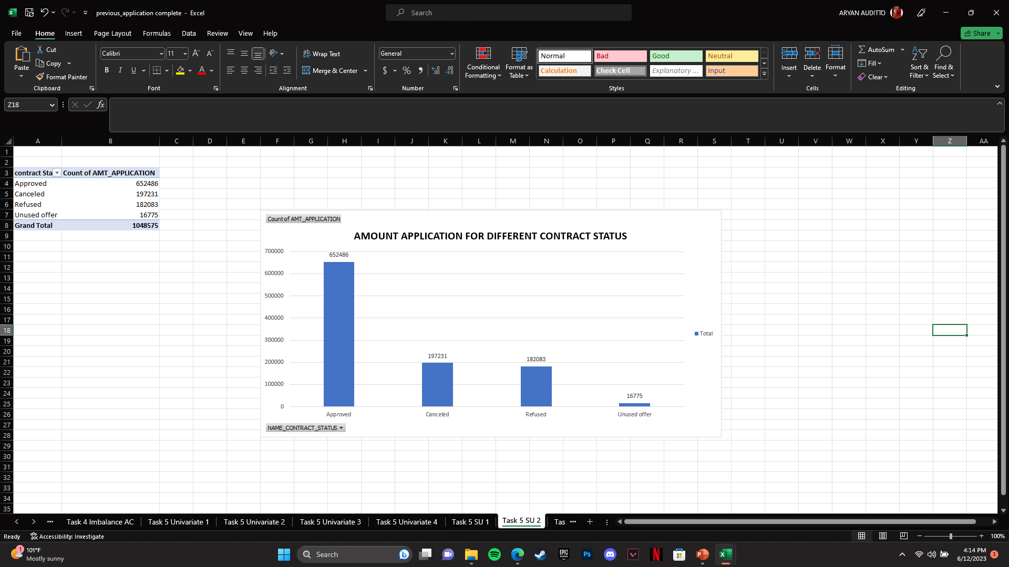
5. Segmented Univariate Analysis :-
Segmented univariate analysis is a technique in data analysis where the dataset is divided into distinct segments or groups based on a single variable, and separate univariate analysis is performed on each segment.
Following shows all the Segmented univariate analysis for application data :
Client applied for more than 200000 of loan have higher chance of getting their application approved.
Clients applied for cash loans and consumer loans are more likely to get approved.

Slide 30
5. Bivariate Analysis :-
Bivariate analysis determining the relationship between two variables. It focuses on understanding how changes in one variable are associated with changes in another variable.
Following shows all the Bivariate analysis for application data :
Majority of the loans applied from credit and cash offices are bound to be cancelled.
Repeater clients are more inclined towards their application getting rejected whereas new clients have much higher chances of getting their application approved.
Walk-ins have lesser chance of having application getting cancelled as compared to x-sell.
Clients under MLM Partners are more inclined towards getting their application rejected as compared to others.
High grouped interest rates have much higher chances of application getting approved.

Slide 31
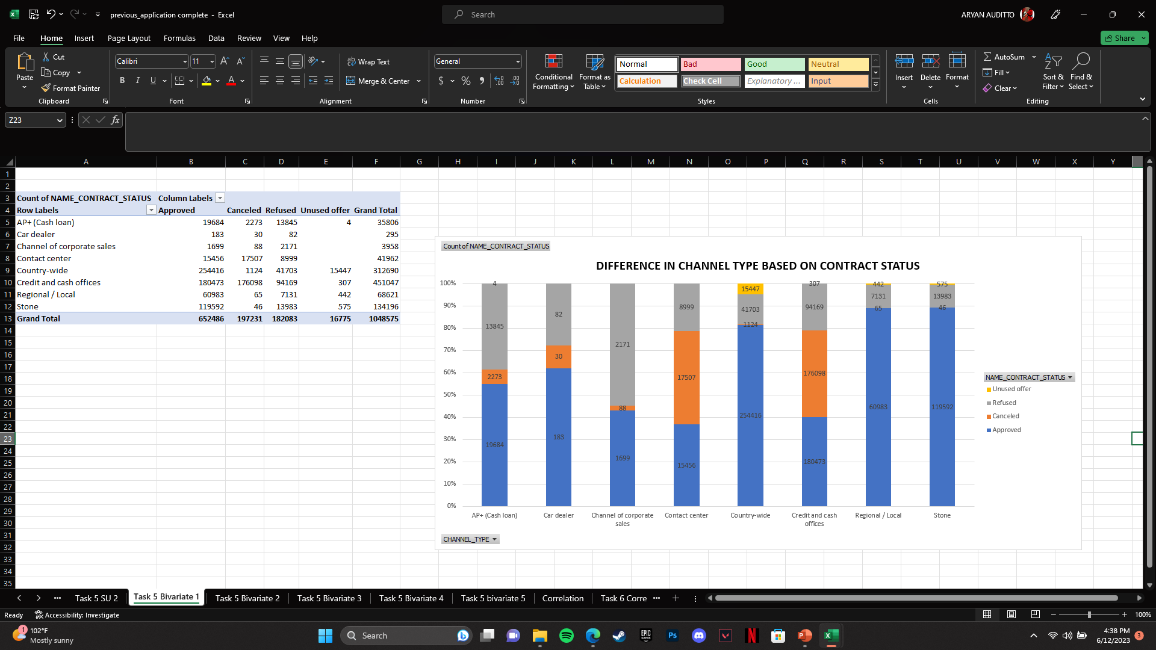
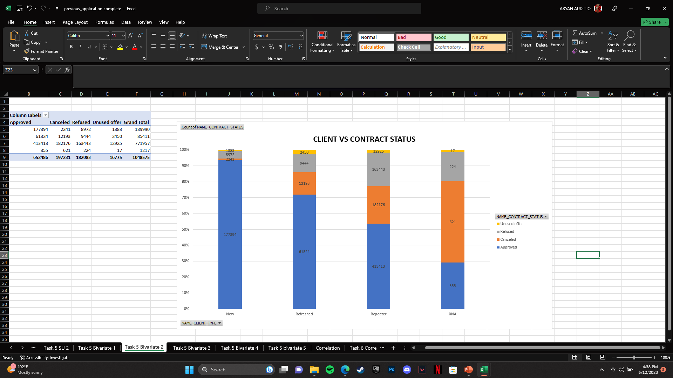
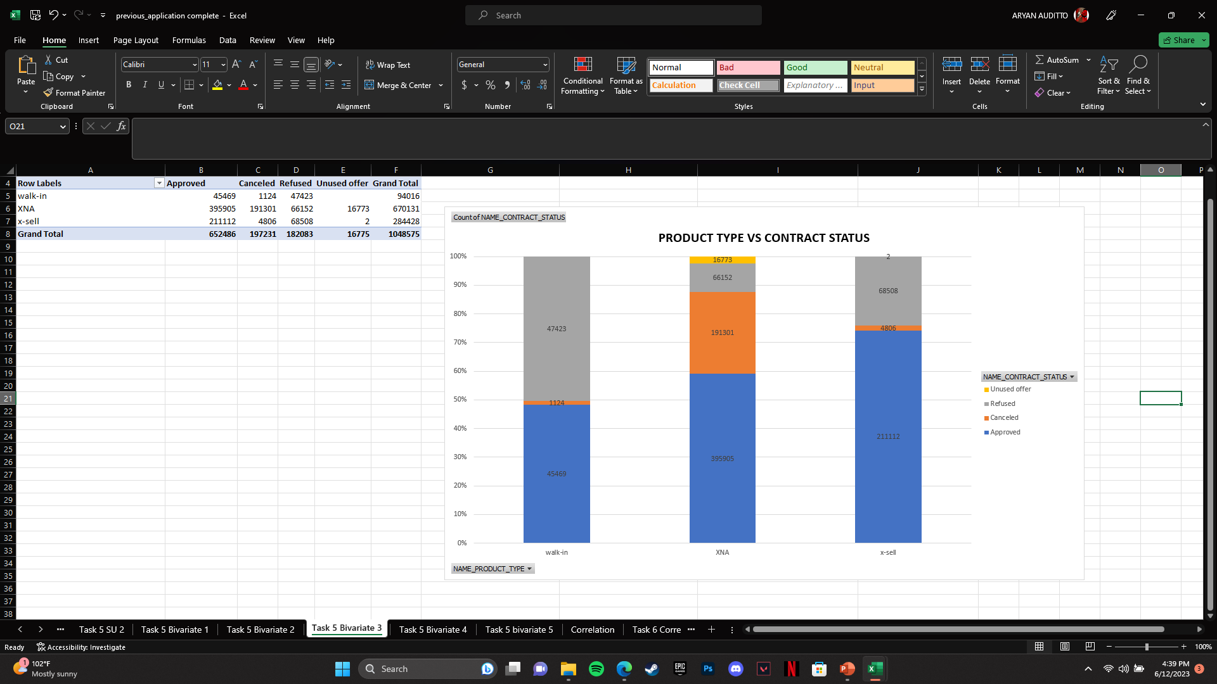
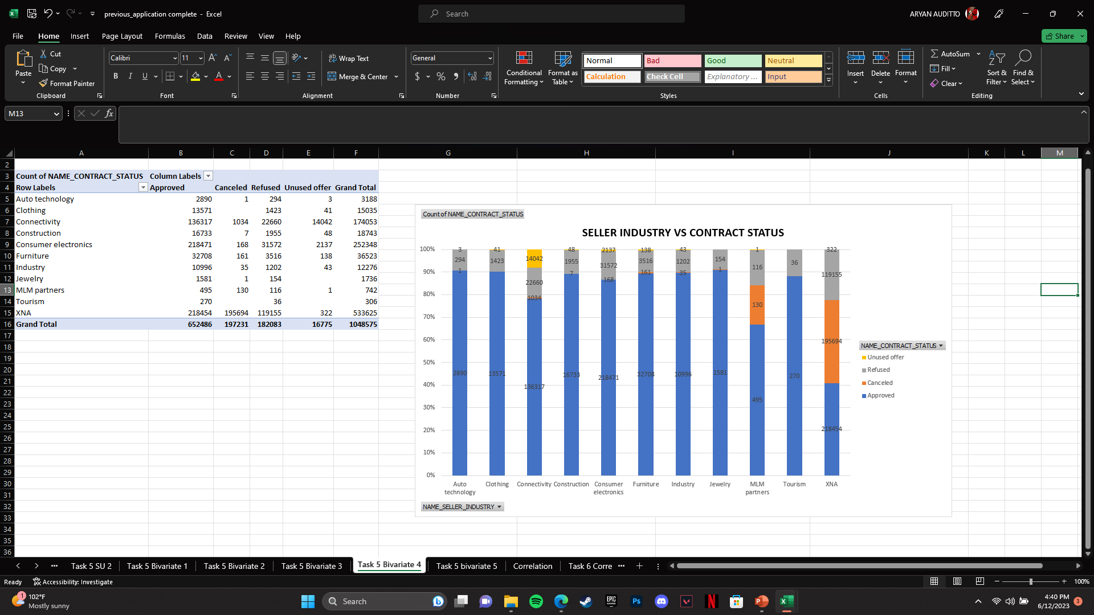
5. Bivariate Analysis :-

Slide 32
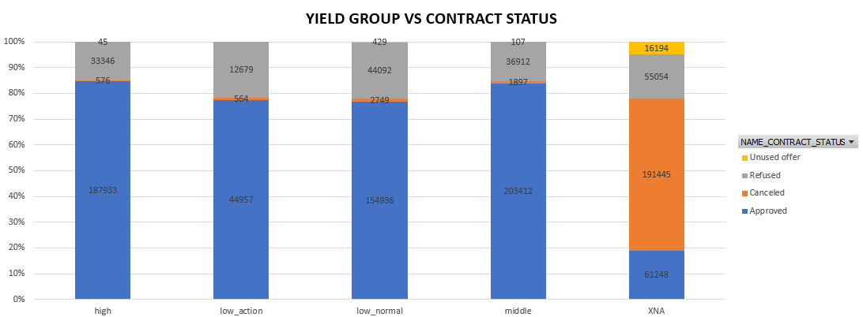
5. Bivariate Analysis :-

Slide 33
6. Correlation :-
Correlation determines the relationship or association between two variables. It indicates the extent to which changes in one variable are related to changes in another variable. Correlation is used to determine the direction (positive or negative) and strength of the relationship between the variables.
Following are top 10 correlation based on cancellation and refusal of applications :
Contract type
Amount application
Amount credit
Cash loan Purpose
Payment type
Client type
Goods category
Product type
Product combination
Channel type

Slide 34
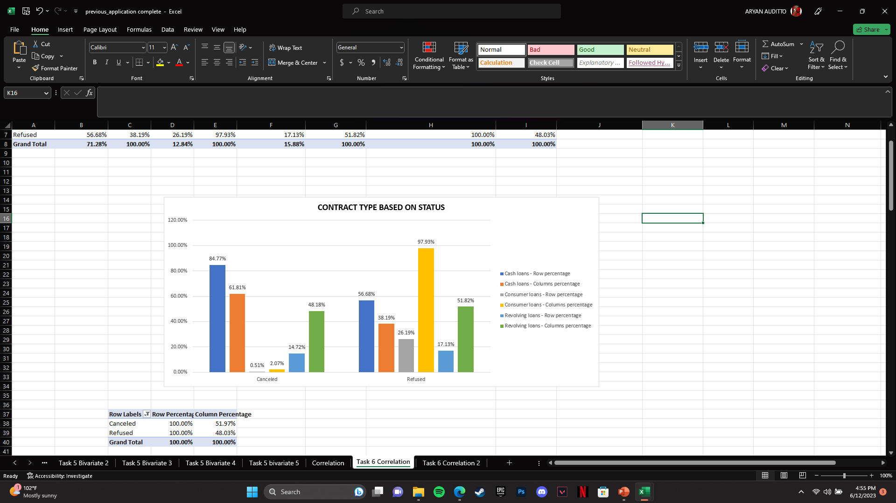
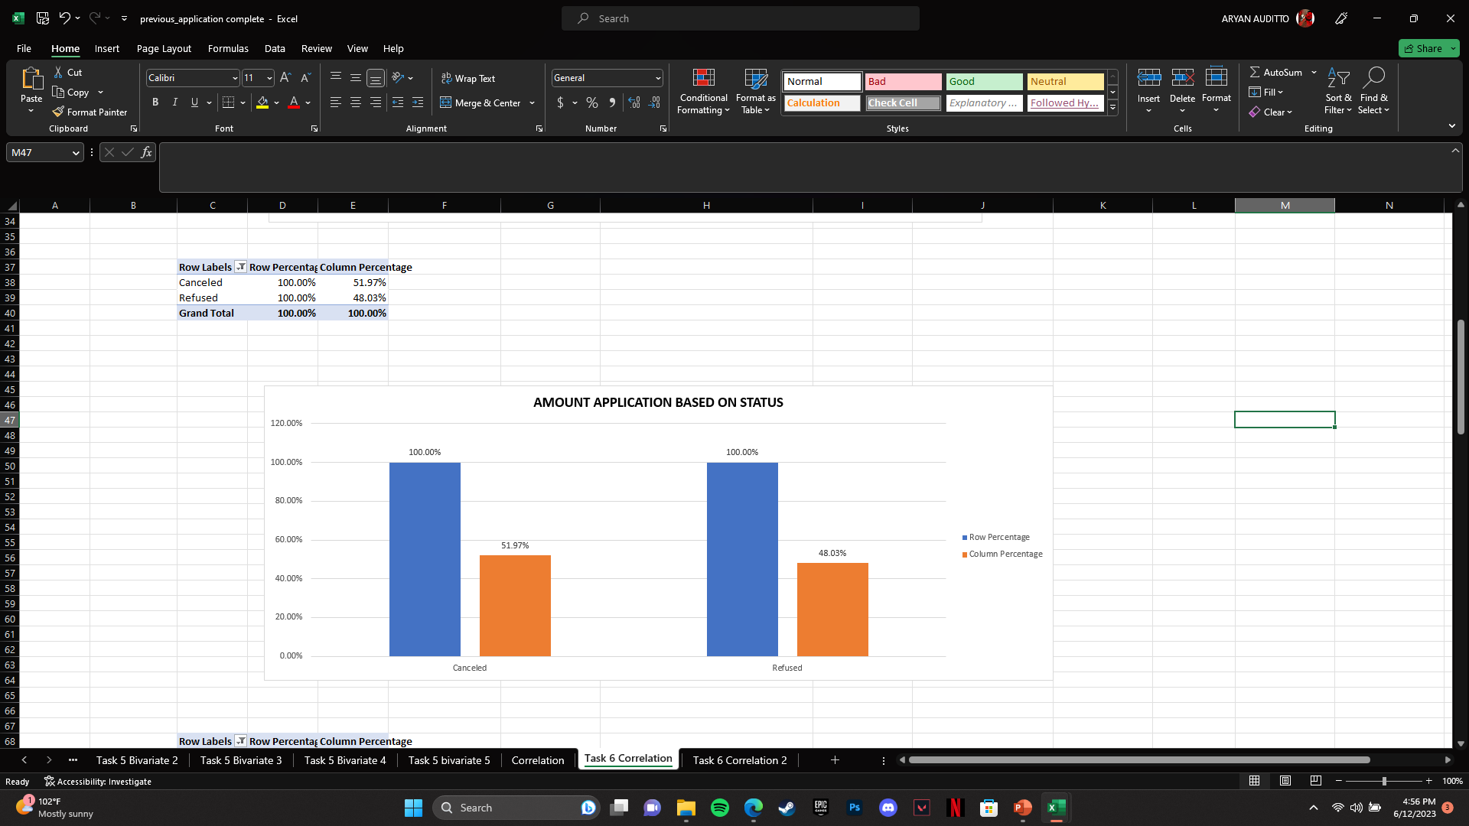
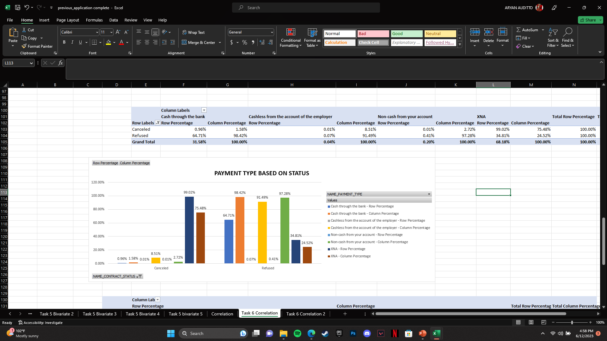

Slide 35
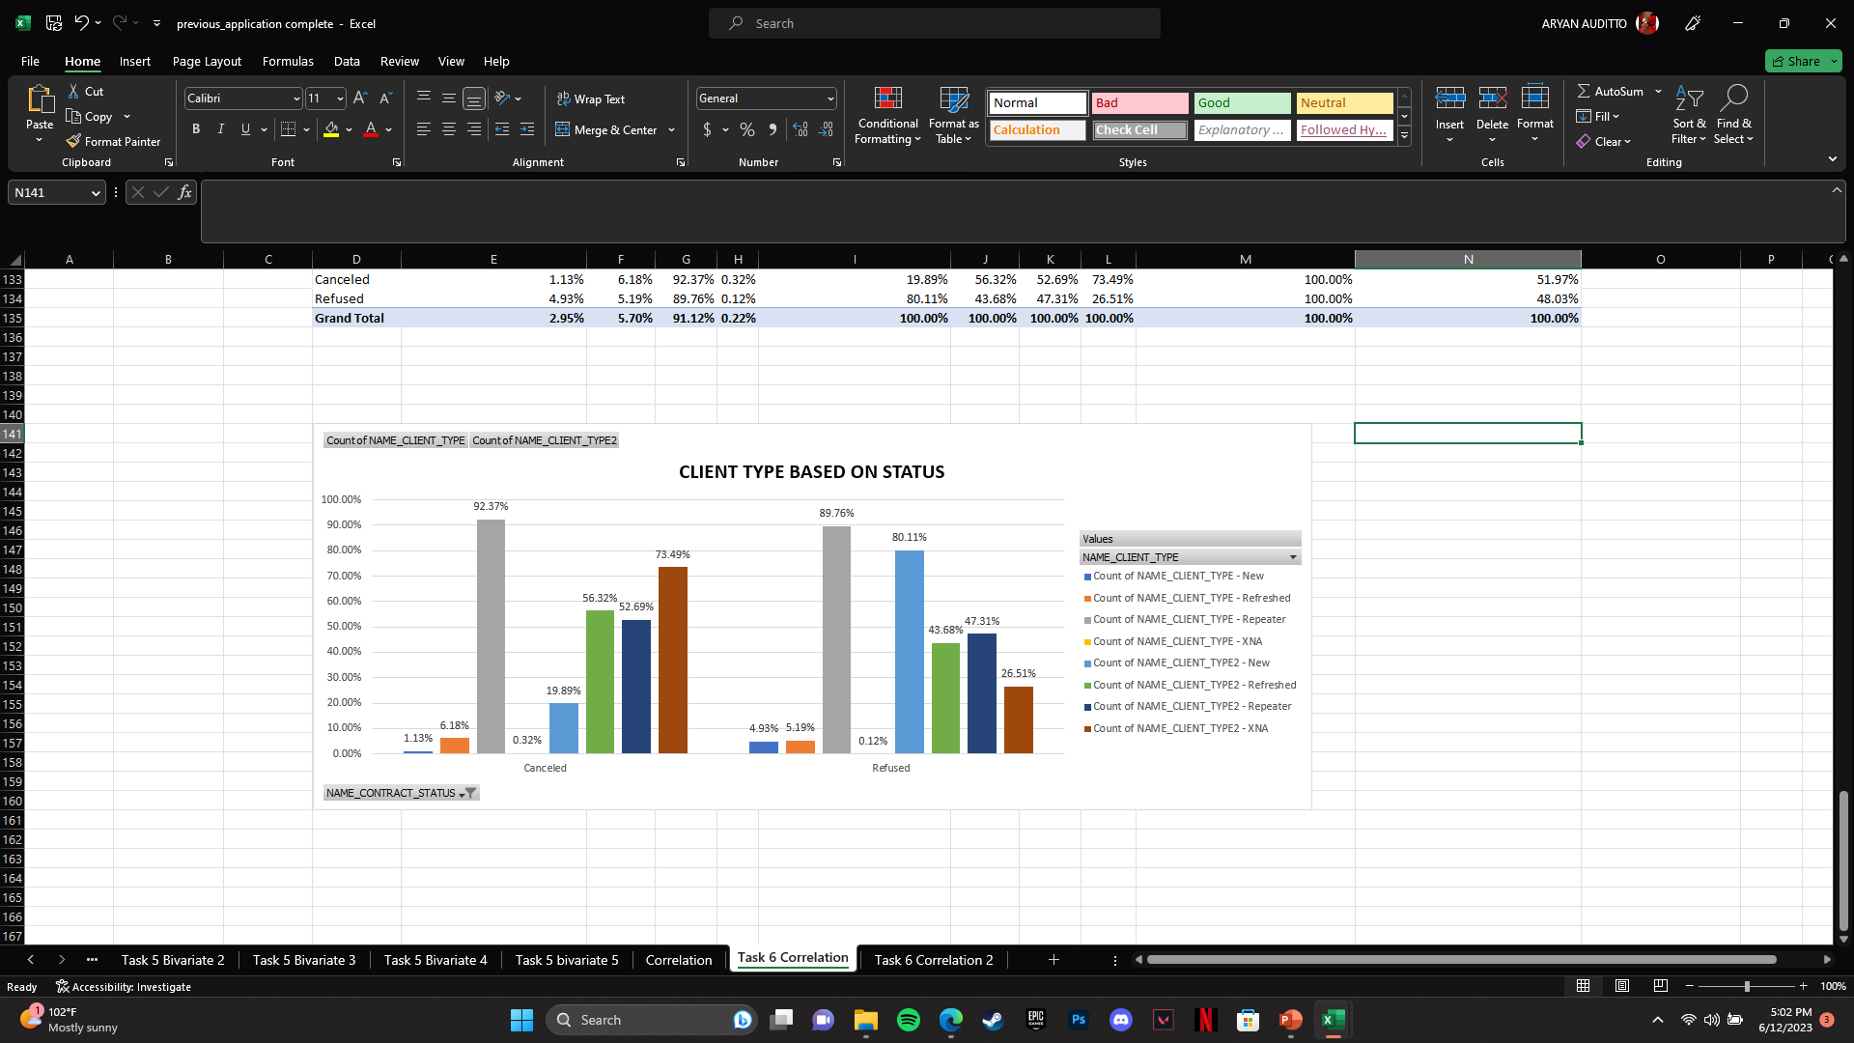
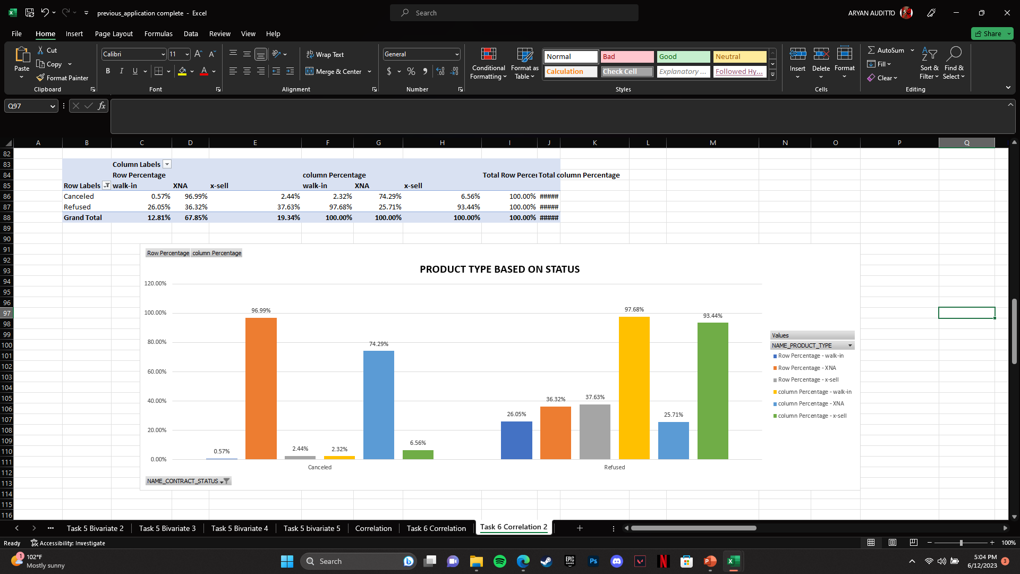
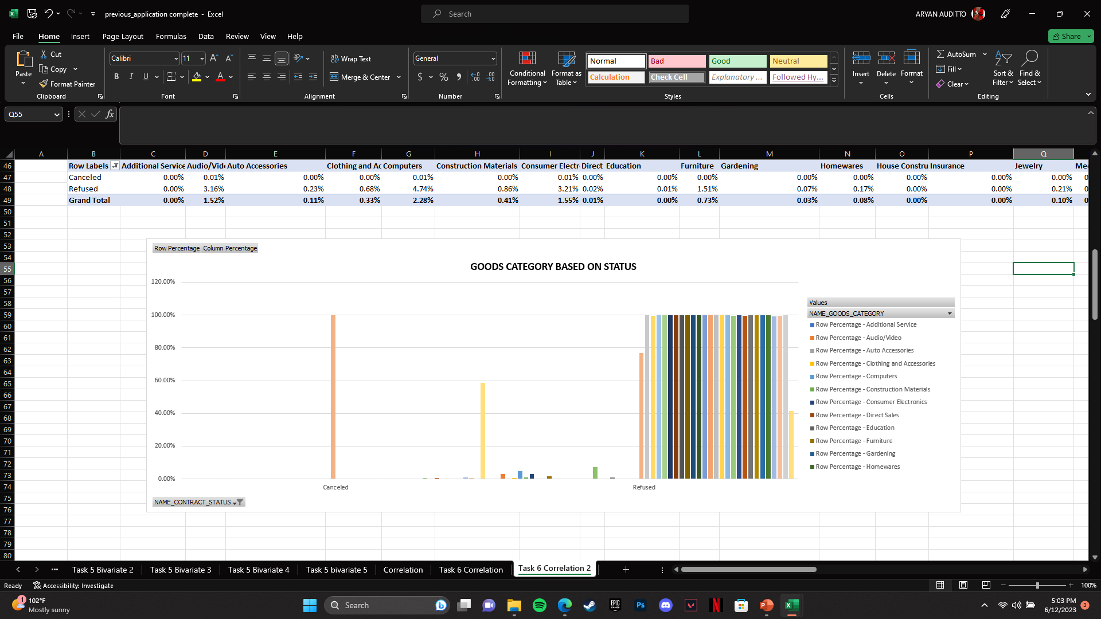
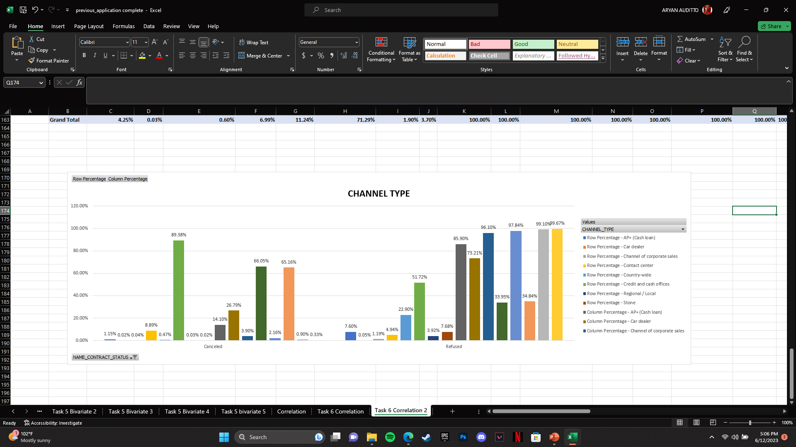
6. Correlation :-

Slide 36
SUMMARY
Clients having lower income have lower chance of getting loan approved as compared to clients with higher income.
Married clients have applied more for loans as compared to others and have better chances of getting their loan approved.
Female clients have better chance of getting their loan approved as compared to men.
Clients with work experience of about 0-5 years have shown to apply the most for loan. Further clients with lesser work experience have higher chances of getting their application cancelled.
Clients being most educated have higher chances of getting approved as compared to ones with lower educations.
Repeaters have higher chance of getting their applications rejected whereas new clients have much higher chances of getting approved.
High grouped interest rates have much higher chances of application getting approved

